Slide 1
7th Grade Parent Night Mrs. Hansen’s Math Class
Marvin Ridge Middle School
2018-2019

Slide 2
North Carolina Standard Course of Study

Slide 3
Ratios & Proportional Relations
Unit Rates
Proportional Relationships
Writing & Solving
Unit conversions
Tables
Direct Variation/Rate of change
Constant of Proportionality
Graphing Direct Proportions
Percents
Simple Interest
Percent of Change
Tax, Discount, Mark-Up,
Commission, Tip/Gratuity
Complete by mid October

Slide 4
Statistics & Probability
Random Sampling
Independent Events
Dependent Events
Describing Data
Comparing Populations
Likelihood of events
Sample Space
Experimental Probability
Theoretical Probability
Tree Diagrams
Fundamental Counting Principles
Complete by early November

Slide 5
Number Systems
Integer Operations
Addition
Subtraction
Multiplication
Division
Fractions
Decimals
Complete by early December

Slide 6
Expressions & Equations
Writing Expressions
Evaluating / Simplifying Expressions
Solving Equations
One Step
Two Step
Using Formulas
Inequalities
Solving
Graphing
Complete by end of January

Slide 7
Functional reasoning
Functions
Linear Relationships- tables, equations, graphs
Slope
Rate of change
Complete by mid March

Slide 8
Geometry
Scale Drawing, Models, Factor
Angle types
Triangles
Area Formulas
Circles
Circumference
Area
Complex Figures
3-Dimensional Figures
Volume
Surface Area
Cross Sections
Complete by mid May

Slide 9
AIG
AIG 7th Grade Math is based on the same basic topics with 8th grade concepts added to create depth and an extra challenge.
AIG math moves at a faster pace to cover more concepts in the same amount of time.

Slide 10
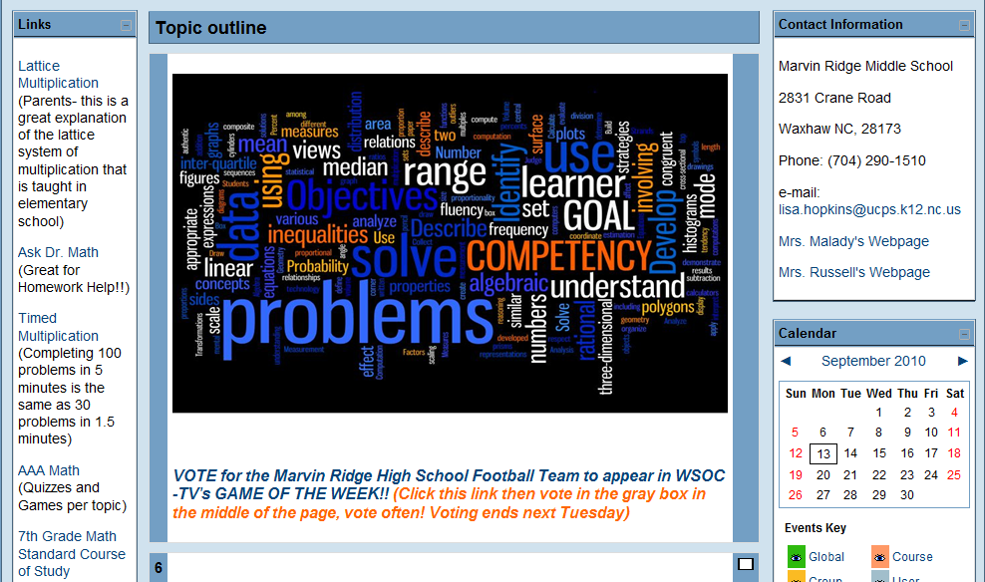
Canvas
Visit the MRMS Website
About Our School
Staff Directory
- Click on next to my name “Hansen”

Slide 11
Organization
3-ring binder (2 inch)
-3 Tabs: (Homework, Graded Quizzes & Tests, Weekly Math)
-2 Spiral Notebooks: (Notes and Warm-ups)
Pencils only should be used for math (with exception for personal notes in notebook)
Colorful pens should be used for checking homework for accuracy

Slide 12
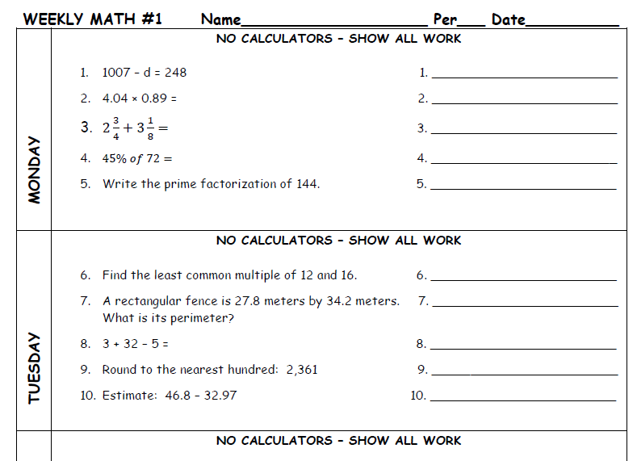
Weekly Math
Assigned every Monday and due the following Monday.

Slide 13
Make Up Work
If a student is absent it is THEIR responsibility to make up any work they missed- this includes homework, notes, quizzes, and tests
Students have two days to complete an assignment for every one day they were absent
Notes must also be caught up if absent

Slide 14
Homework
Assigned almost every night
Checked for completion, only graded for accuracy occasionally
Work must be shown and all problems should be completed
No homework will be accepted in pen
Homework is not accepted late
They check it for accuracy after it is marked for completion.
IXL assignments are given for longer periods of time.

Slide 15
Grading Policy
Grades are weighted
Assessments 60%
Classwork/Weekly Math/IXL 30%
Homework 10%

Slide 16
Contact Me!
Email: lisa.hansen@ucps.k12.nc.us
Phone: 704- 290- 1510

