Slide 1
Canvas
Uploading Tips for students

Slide 2
Submitting Via Textbox
Open the textbox
Respond
Submit

Slide 3
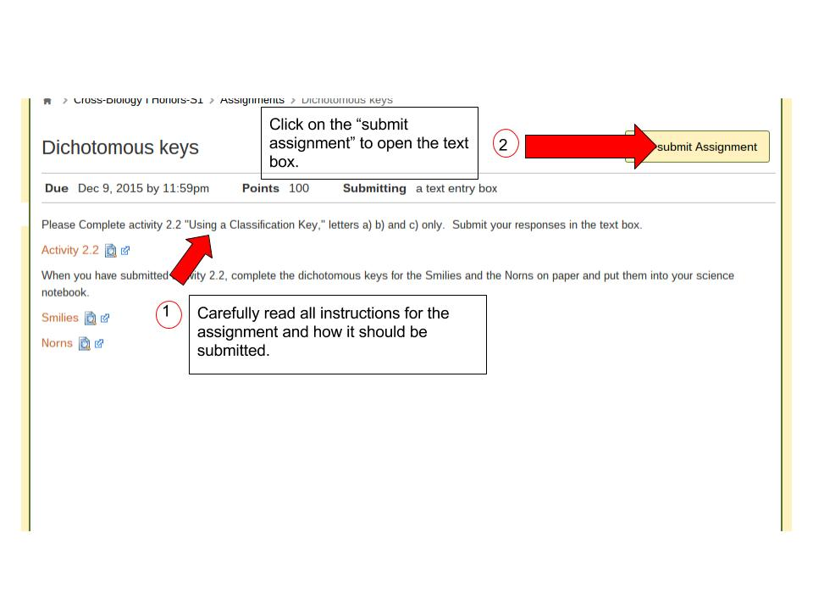

Slide 4
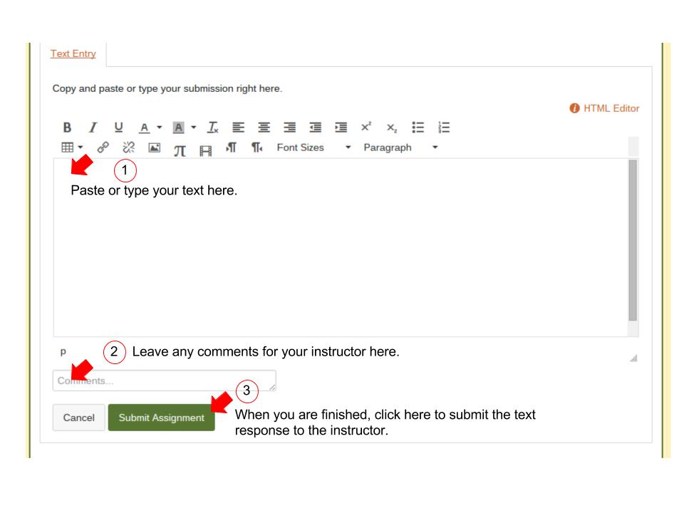

Slide 5
Submitting Via URL
Create
Share
Make sure the URL is “shareable.”
For example, in a shared Google folder or public website.
Copy and paste
Submit
Note: For this method of submission, only one URL is allowed. If it is for an assigned group on Canvas, only one submission per group is allowed. Last one to submit wins! (The last shared URL is the one the instructor will get.)

Slide 6
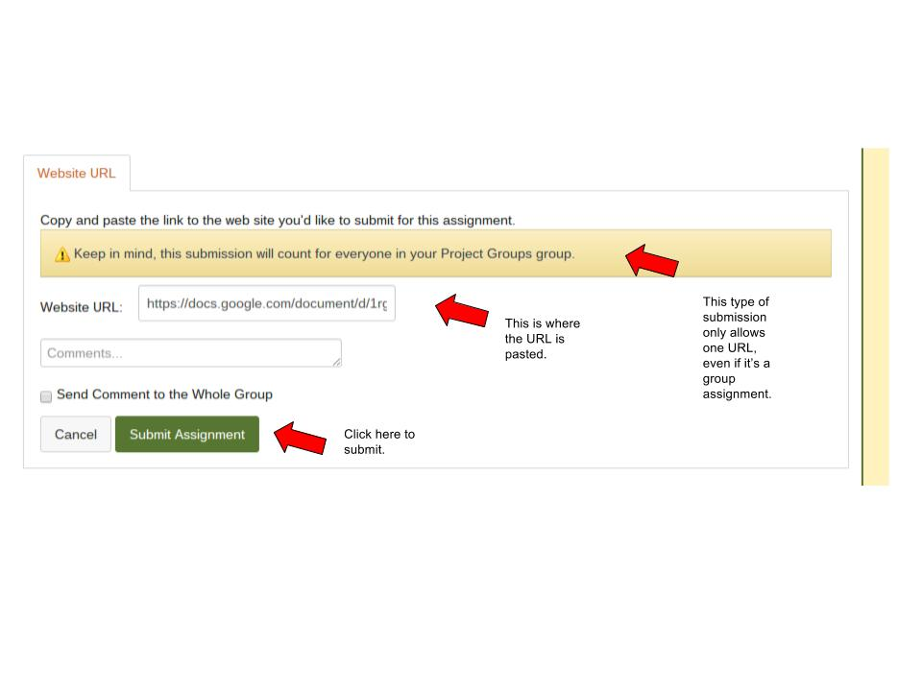

Slide 7
Uploading a single file (Google Document)
Create
Upload
Authorize
Submit
Confirm

Slide 8
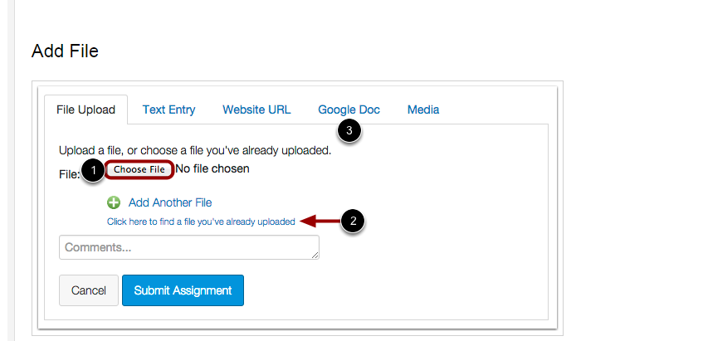
Click here

Slide 9
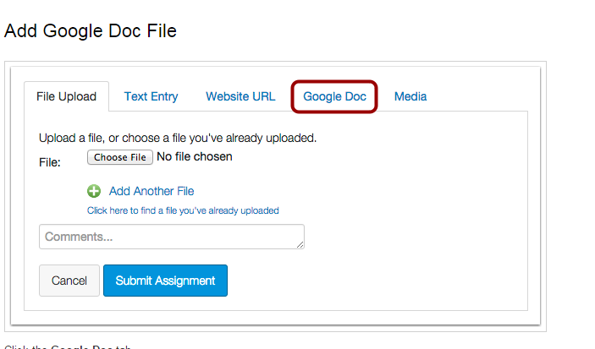

Slide 10
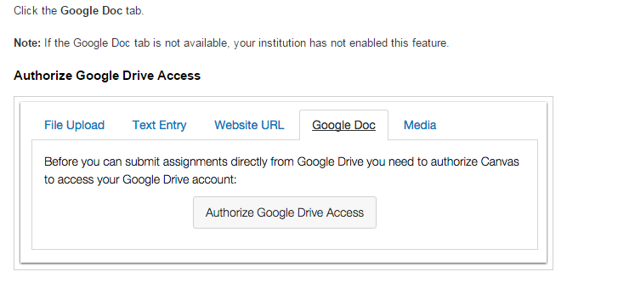

Slide 11
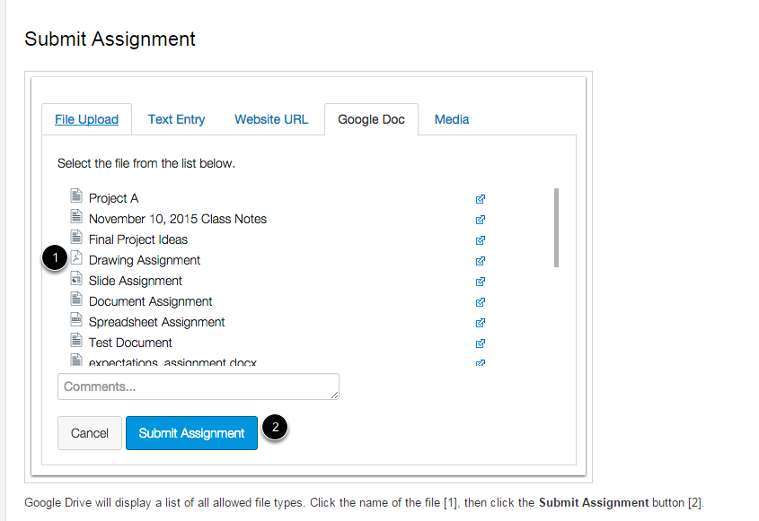
Select Google doc

Slide 12
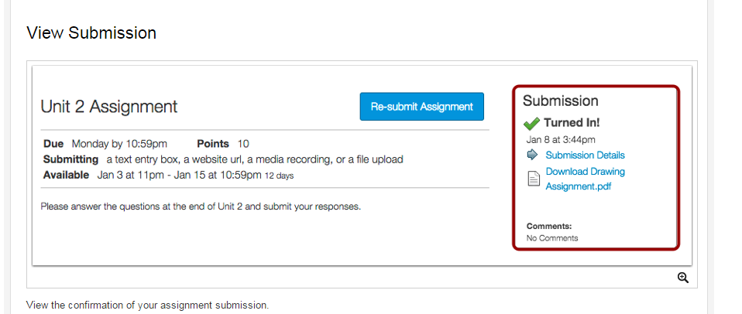

Slide 13
Uploading Multiple Files
Create
Convert
Upload (add files)
Submit
Confirm

Slide 14
Don’t forget to Convert!
When uploading multiple documents the first thing you have to do is change your Google document/presentation to a Microsoft document.

Slide 15
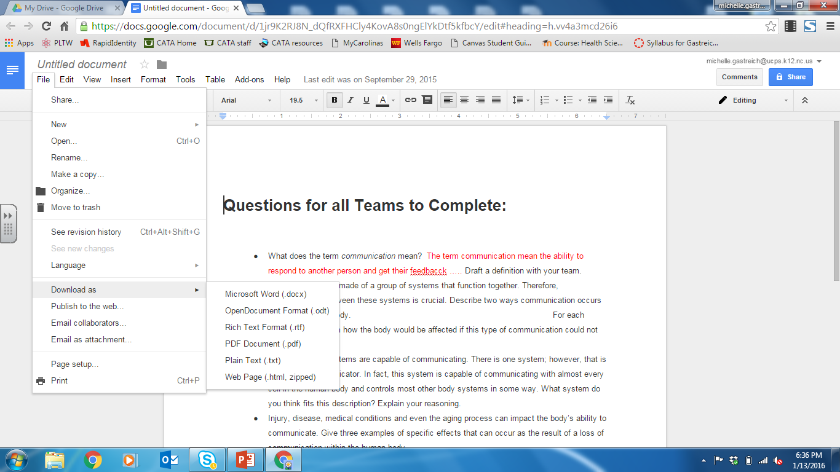

Slide 16
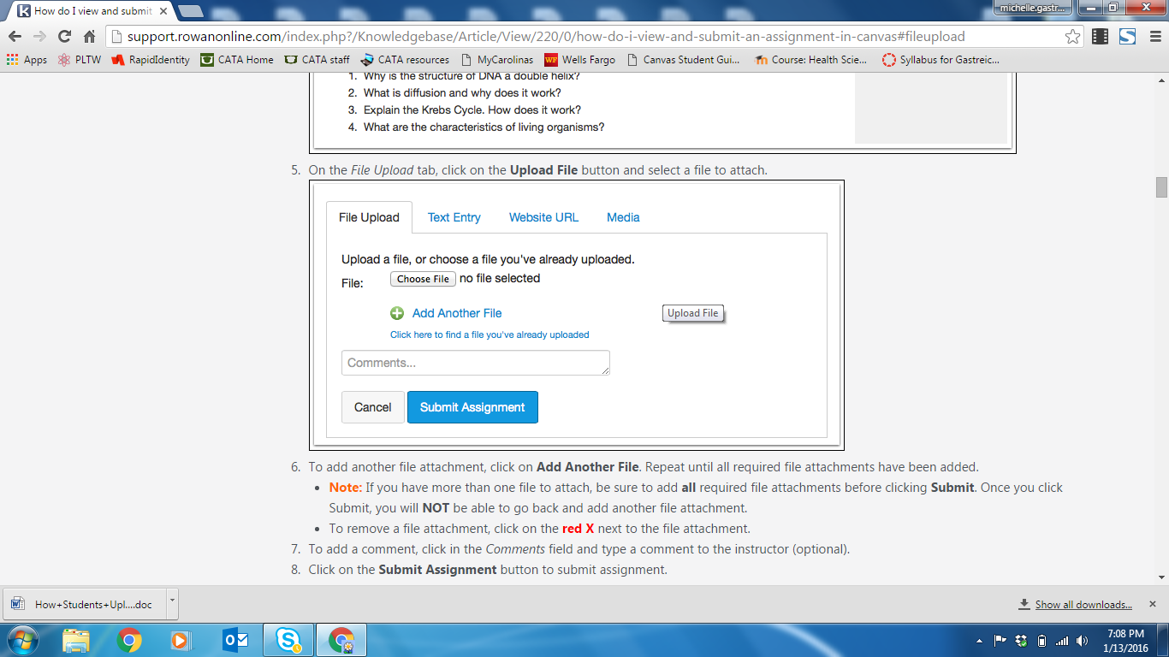
1
2
3

Slide 17
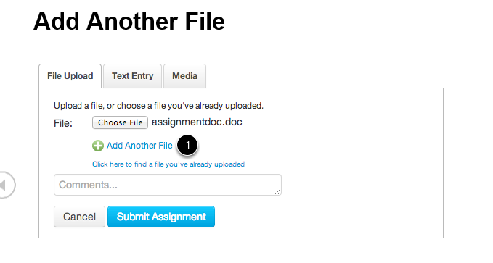
Your Word document
will show here
Add another file

Slide 18
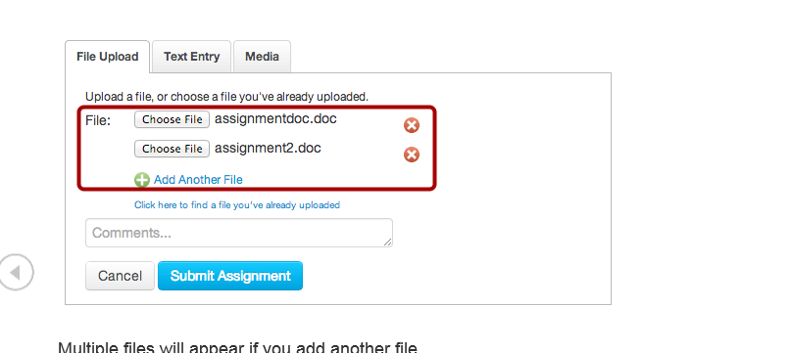
Both documents
appear here

Slide 19
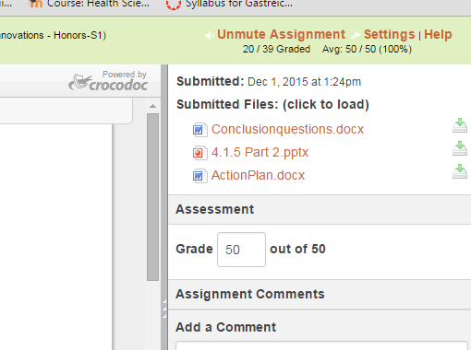
Here is a submission
of 3 documents

