Slide 1
Rules Covid 19 adapted

Slide 2
No facemask politics
Right or wrong at this moment everything we get to do on a social level is debated at best and at worse considered a privilege.
Follow all Covid procedures.
6 ft
Differentiating between legitimate safety concerns and detailed got-ya.
It will get better
Polio

Slide 3
Chrome Book Discipline
Eyes up front
I promise you I know who is listening and who is not.
‘Existing’ on your phone. Resisting newly formed or forming habits.
Good and Bad of Technology (distraction from reality, manipulation)

Slide 4
KEEP YOUR SEAT UNTIL THE BELL RINGS
WHY I HATE THIS
Many problems are caused by students mingling with one another prior to the bell.
Touching and horsing around typically lead to larger problems.
DO NOT LINE UP AT THE DOOR

Slide 5
Be on time
Habits
Avoids Covid drama

Slide 6
ALWAYS COME PREPARED
CHROME BOOK CHARGED

Slide 7
YOUR ASSIGNED SEAT IS EXACTLY WHAT ITS DEFINITION IMPLIES
NOT A SUGGESTION
IF YOUR SEAT IS A PROBLEM, TALK TO ME AFTER CLASS

Slide 8
SPEAKING OUT OF TURN, CLOWNING AND GENERAL DISRUPTIONS
THESE ARE SELFISH ACTS AND ARE CONTRARY TO THE OBJECTIVES OF THIS CLASS
DON’T BE SELFISH
DON’T BE SELFISH
DON’T BE SELFISH
DON’T BE SELFISH YOU ARE TAKING AWAY FROM YOUR CLASSMATES.

Slide 9
CELL PHONES AND CHROMEBOOKS
CELL PHONES GO IN THE CADDY AT THE BEGINNING OF CLASS. IF ALL OBJECTIVES ARE ACCOMPLISHED AT THE END OF CLASS YOU MAYBE ALLOWED TO COLLECT THEM EARLY. HEALTH.
NO HEADPHONES WITH CHROMEBOOK OUT WHEN THAT IS NOT THE ASSIGNED TASK. OFTEN ENGAGED IN NON PRODUCTIVE ACTIVITY.

Slide 10
NO SLEEPING
IF YOU ARE SLEEPING YOU WILL BE ASKED TO WAKE UP AND MAY VOLUNTARILY STAND AT THE BACK OF THE CLASS
GET CONTROL OF YOUR LIFE. Good and bad
IF YOU ARE ASKED AGAIN YOU WILL BE ASKED TO STAND AT THE BACK OF THE CLASSROOM
HELP ME HELP YOU

Slide 11
STAY ON TASK
WE WILL PLAY GAMES, THIS IS NOT A FREE TIME TO TALK AND GOOF OFF.
WE WILL WATCH MOVIES, THIS IS NOT A TIME TO CATCH UP ON SOME SLEEP
WE WILL WORK IN GROUPS, KEEP THE CONVERSATION AS RELEVANT TO THE SUBJECT MATTER AS POSSIBLE.
ALL OF THE ABOVE ACTIVITIES CAN BE REVOKED AND REPLACED WITH A WORKSHEET OR QUIZ

Slide 12
CHEATING
A RELATIVLEY SAFE ENVIRONMENT TO MAKE MISTAKES, lazy?
MAKES THE CLASS A WASTE OF YOUR TIME
TRYING TO MAKE A STRONG EFFORT TO ELIMINATE THE TEMPTATION OF IT

Slide 13
RESPECT
IT IS THE CORNERSTONE OF A SUCCESFUL CLASSROOM
RESPECT ONE ANOTHER, RESPECT ME AND WE WILL ALL WALK OUT OF HERE FEELING ALRIGHT.
BULLYING, MAKING SOMEONE ELSE FEEL BAD TO MAKE YOURSELF FEEL GOOD.
PG conversations

Slide 14
BATHROOM AND ELECTRONIC DEVICES
ONE AT A TIME TO THE BATHROOM UNLESS IT IS A DESIGNATED BREAK
TAKE CARE OF BATHROOM BEFORE CLASS, DO NOT RAISE YOUR HAND TO INTERUPT LECTURE SO YOU CAN USE THE BATHROOM
Phones in caddy

Slide 15
CONSEQUENCES
WARNING – (ONLY FOR MINOR INFRACTIONS SEE SCHOOL RULES) RESULTS IN IMMEDIATE HALLWAY CONFERENCE WITH ME. BE PREPARED TO EXLPAIN WHY YOU ARE BEHAVING IN THE MANNER YOU ARE. Call home.
NOTHING IS PERSONAL.

Slide 16
WORK ACTIVITY
State Geography game
Go to Learning Modules and select your day of the week.
Click on the State Geography game.
https://lizardpoint.com/geography/usa-quiz.php

Slide 17
PROCEDURES
HOW THIS CLASS WILL BE CONDUCTED AND GRADED
PLEASE HOLD QUESTIONS UNTIL THE END OF EACH SLIDE

Slide 18
DAILY SCHEDULE
MONDAY - THURSDAY
PEOPLE IN CLASS GAME & QUIZ / TEST.
VIRTUAL STUDENTS – Observe Games/ teams group work /complete Stanford History assignment
STANFORD HISTORY
PRIMARY RESOURCE ASSIGNMENTS
EVERYONE
ADMIN/HISTORY CONTENT NOTES
EVERYONE
1st
30
Minutes of class
2nd
30
Minutes of class
3rd
30
Minutes of class

Slide 19
GRADES
EXAMS/PROJECTS – 40 % OF THE GRADE IS DETERMINED BY APPROXIMATLEY 2 OR 3 TESTS EVERY 6 WEEKS
QUIZES – 25 % ANYWHERE FROM 7 TO 9 QUIZES PER 6 WEEKS. CLASS WORK ALSO FALLS INTO THIS CATEGORY TO HELP INCREASE THE GRADE.
CLASS WORK - PARTICIPATION/HOMEWORK – 35 %

Slide 20
EXAMS
40 % OF THE GRADE IS DETERMINED BY APPROXIMATLEY 2 to 3 TESTS EVERY 6 WEEKS
Mixture of writing and multiple choice

Slide 21
QUIZES
…..IMPORTANT…….QUIZES ARE FILL IN THE BLANK
YOU WILL BE PROMPTED BY THE NOTES IN THE SLIDES (THEY GIVE YOU HINTS AS TO WHAT WILL BE ON THE SLIDES)

Slide 22
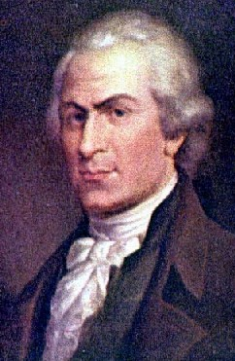
FINANCIAL DEBATE
-nation had large war debt
-Alexander Hamilton’s plan
-tariff
-pay all debts
-national bank system
-debate over power to create a national bank
-implied powers?

Slide 23
QUIZES 25%
TAKEN ABOUT EVERY OTHER DAY AND GRADED BY TEACHERS AID. LAST 4 OF LUNCH NUMBER ON PAPER(ONE WORD ANSWERS)
YOU LEARN FROM SLIDES, GAMES AND GROUP ACTIVITES AND YOU TAKE QUIZ NEXT DAY
Quiz should take about 15min
Rules-
When finished turn over paper
No whisper answers. I will take quiz and give zero.
Don’t distract others with any actions during quiz

Slide 24
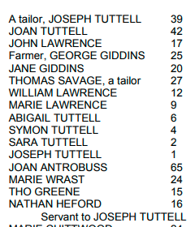
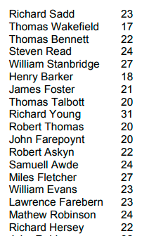
CLASSWORK 35%
Will mostly consist of Stanford Education Group.
Describe the “typical” English immigrant to the New World in terms of gender, age, and marital status on each of the ships. How does this differ on the two ships?
New England
Virginia

Slide 25
Make up for the previously mentioned
YOU MUST SEE ME PRIOR TO CLASS OR AFTER CLASS. IT IS YOUR RESPONSIBILITY TO GET THE WORK FROM ME.

Slide 26
Participation/Homework
POINTS ARE ADDED FOR:
WINNING GAMES
GENERAL GOODNESS, CAN BE AWARDED CLASS WIDE. ATTENDANCE FOR TESTS.

Slide 27
QUICK NOTE ON TEMPERATURE
I DON’T WANT ANYONE TO SUFFER OVER THE TEMPERATURE, HOWEVER THERE ARE ABOUT 30 PEOPLE IN HERE SO IT IS IMPOSSIBLE TO GET IT RIGHT.
IF YOU GET COLD EASILY OR CHOOSE TO DRESS LIKE IT IS GOING TO BE 110 DEGREES IN HERE THEN YOU SHOULD BRING A BLANKET OR SWEATSHIRT.
DON’T INTERUPT OTHERS OR ME TO BEG FOR A TEMPERATURE CHANGE BECAUSE YOU ARE COLD OR HOT. I WILL ADDRESS THIS AS BEST AS I CAN PRIOR TO THE START.
NO COMPETETIVE TEMPERATURE ARGUING

Slide 28
TIPS FOR SUCCESS IN THIS CLASS
NOTES ARE PROVIDED FOR YOU. THIS IS SO YOU ARE NOT CONCENTRATING ON WRITING WHEN YOU SHOULD BE CONCENTRATING ON LISTENING. LISTENING DURING LECTURE WILL BE YOUR GREATEST ASSET FOR THIS CLASS.
YOU SHOULD HEAR OR STUDY TESTABLE MATERIAL ABOUT 6 TIMES PRIOR TO TAKING THE TEST.
IN LECTURE (THIS IS WHERE YOU WILL HEAR IT FIRST AND RECEIVE THE MOST INFORMATION ABOUT THE MATERIAL, THIS ADDITIONAL INFORMATION IS ALSO HELPFUL FOR DEEPER UNDERSTANDING)
STUDYING AFTER A LECTURE: IF YOU PAID ATTENTION DURING THE LECTURE A QUICK 15 MINUTE REVIEW OF THE CONTENT WILL BE PERFECT. REPLAY THE STORIES AND CONCEPTS TO YOURSELF OR A FAMILY MEMBER. USE THE NOTES AS A GUIDE. IF YOU DON’T REMEMBER SPECIFIC MATERIAL , LISTEN CLOSELY TO THE GAMES AND MY QUICK REVIEW THE NEXT DAY.
IN A GAME , TIP: PAY ATTENTION DURING THE GAMES. THIS CANNOT BE SAID ENOUGH. DON’T RUIN GAMES FOR YOUR PEERS , IT IS AN OPPORTUNITY FOR FUN LEARNING.
MY REVIEW PRIOR TO TAKING THE QUIZ.
IN AN ACTIVITY, SKIT, WORKSHEET ETC
TEST REVIEW.
STUDENTS WHO RELY ON ONLY ONE OR TWO OF THESE MODES OF LEARNING DON’T DO VERY WELL.
STUDENTS WHO USE ALL OF 6 OF THESE GET AN A.

Slide 29
HOMEWORK PURCHASE YOUR 3 RING BINDER
PURCHASE YOUR 3 RING BINDER
PURCHASE YOUR 3 RING BINDER
PURCHASE YOUR 3 RING BINDER
PURCHASE YOUR 3 RING BINDER
PURCHASE YOUR 3 RING BINDER
PURCHASE YOUR 3 RING BINDER
PURCHASE YOUR 3 RING BINDER

Slide 30
Born in Charlotte (MATTHEWS)

Slide 31
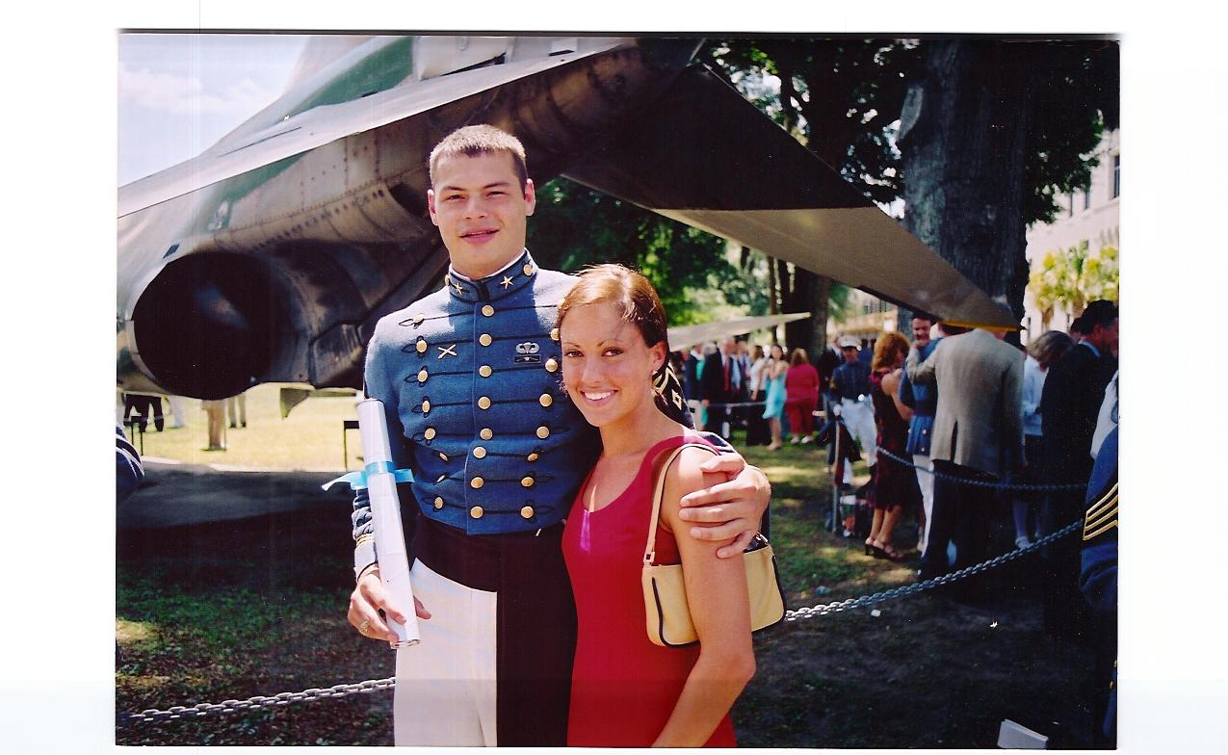
Went to Citadel

Slide 32
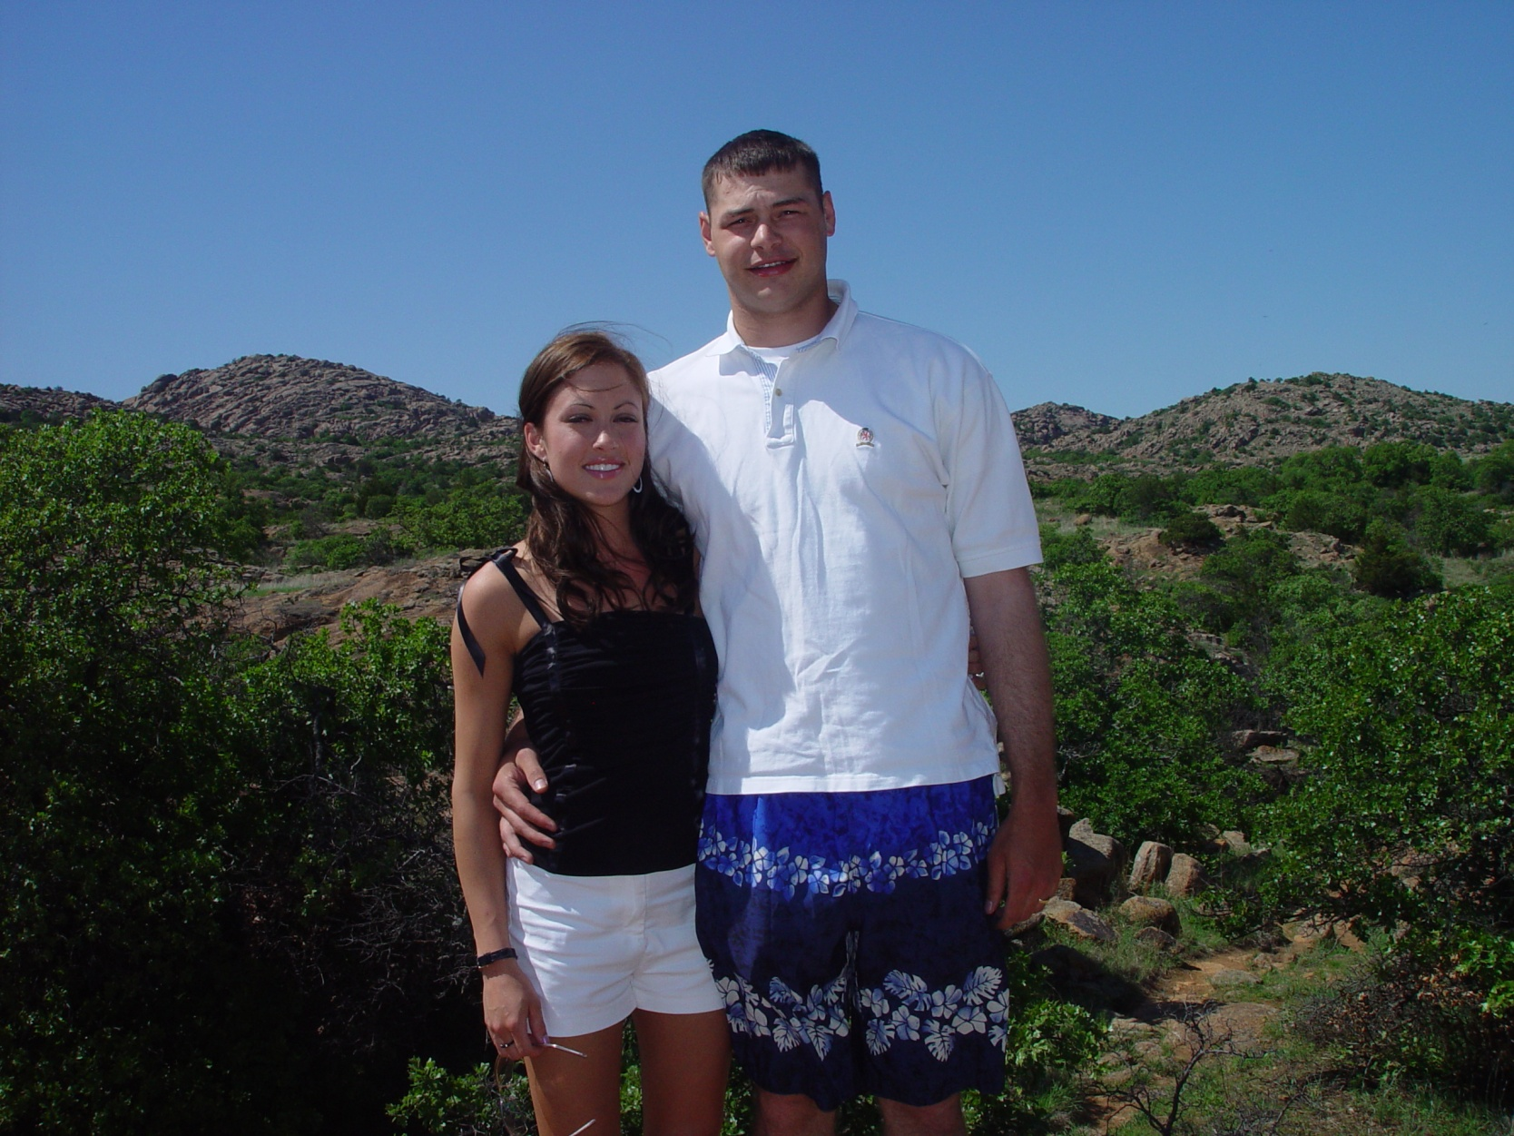
Went to Oklahoma

Slide 33
Went to Washington

Slide 34
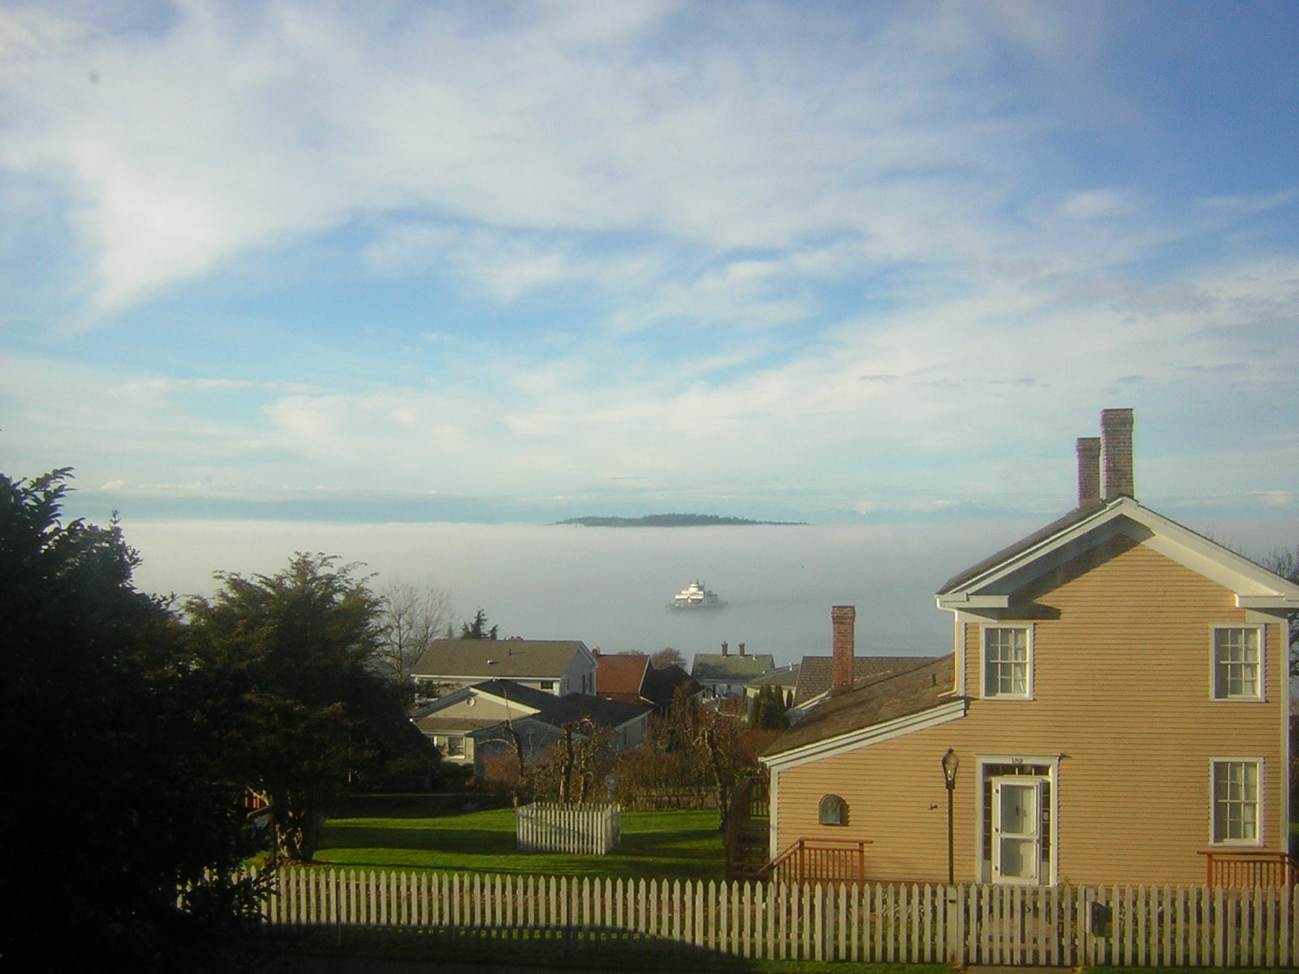
WASHINGTON

Slide 35
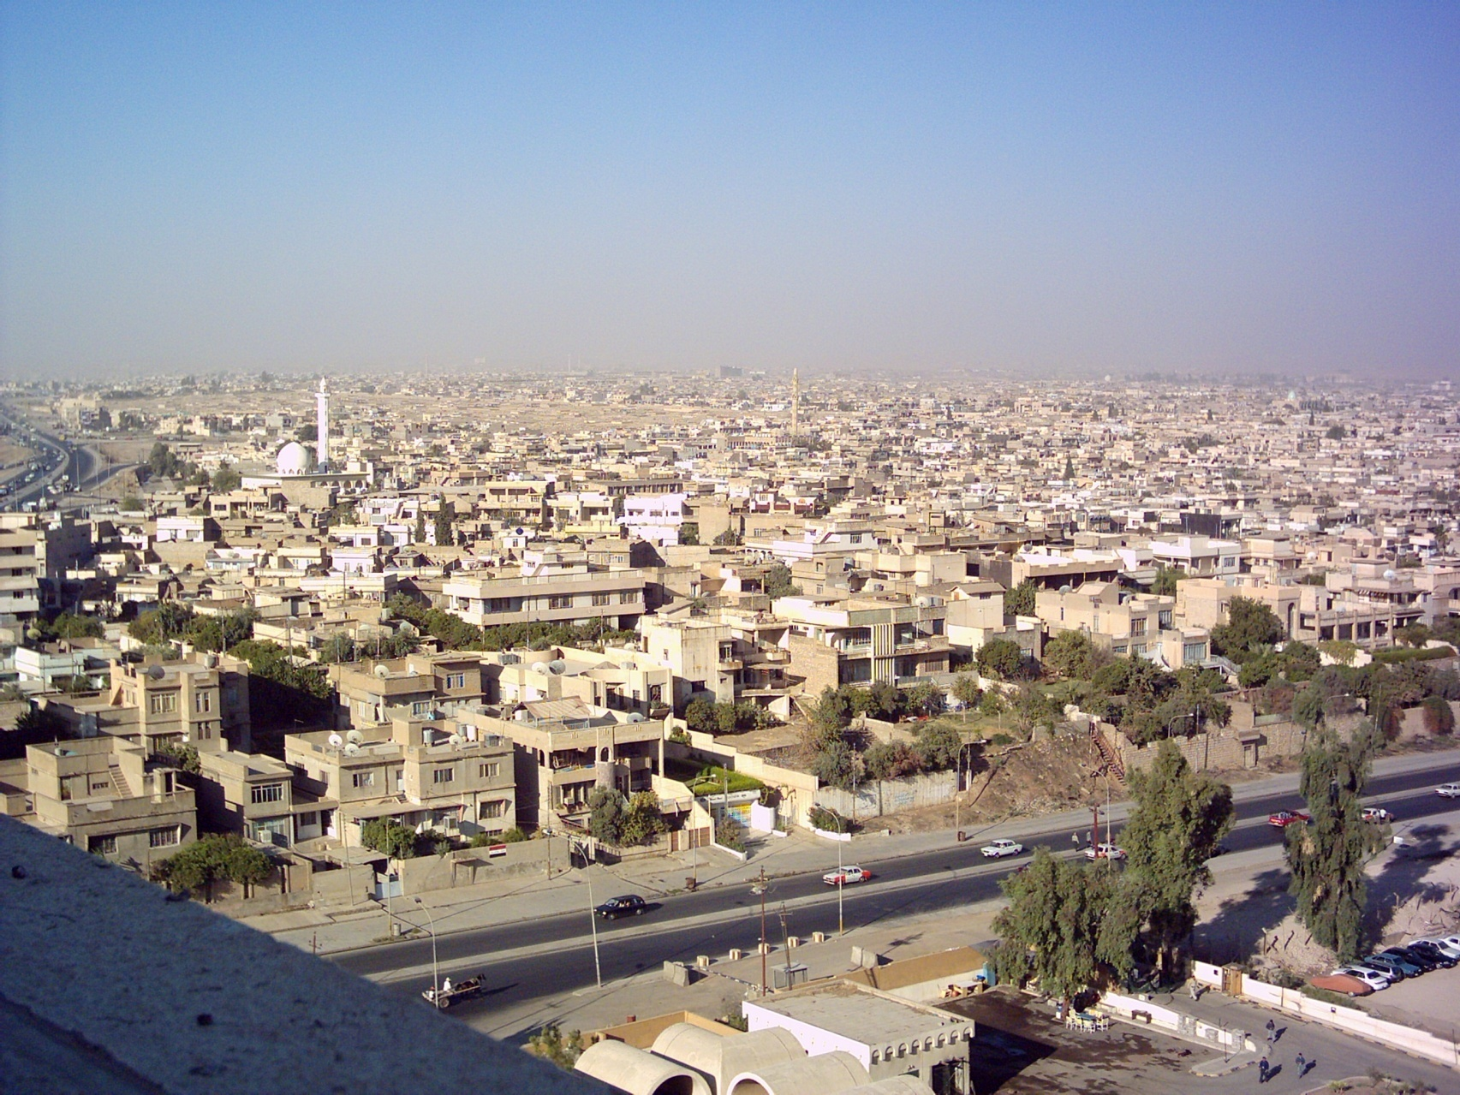
WENT TO IRAQ

Slide 36
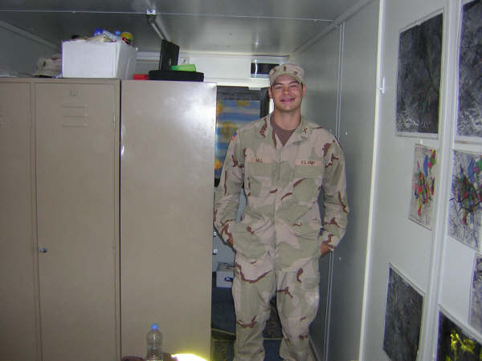
IRAQ

Slide 37
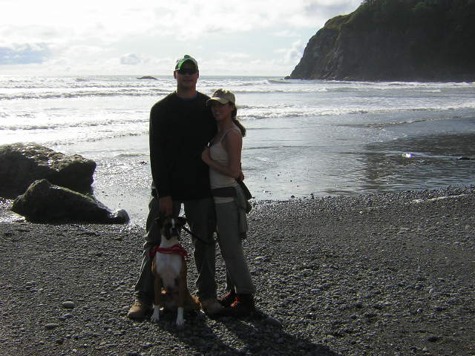
BACK TO WASHINGTON

Slide 38
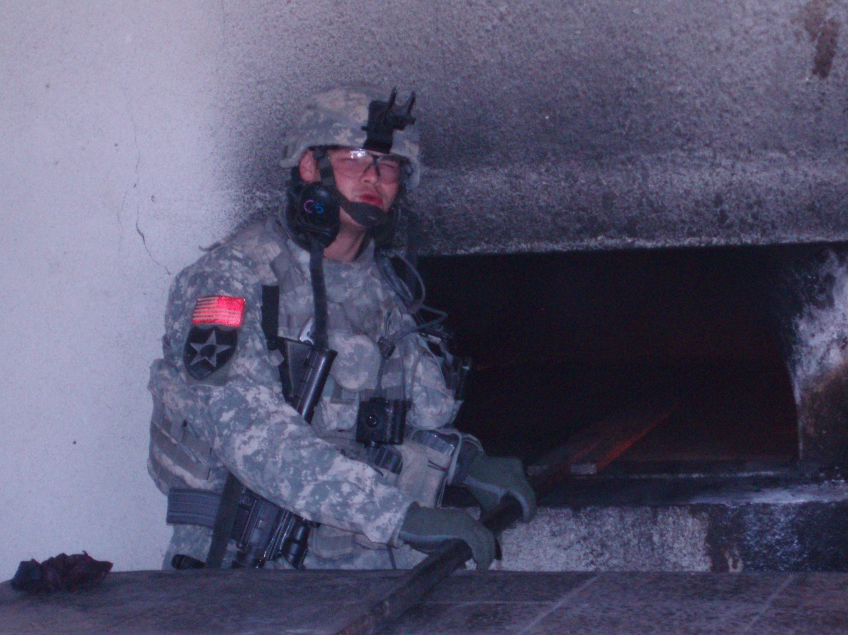
BACK TO IRAQ

Slide 39
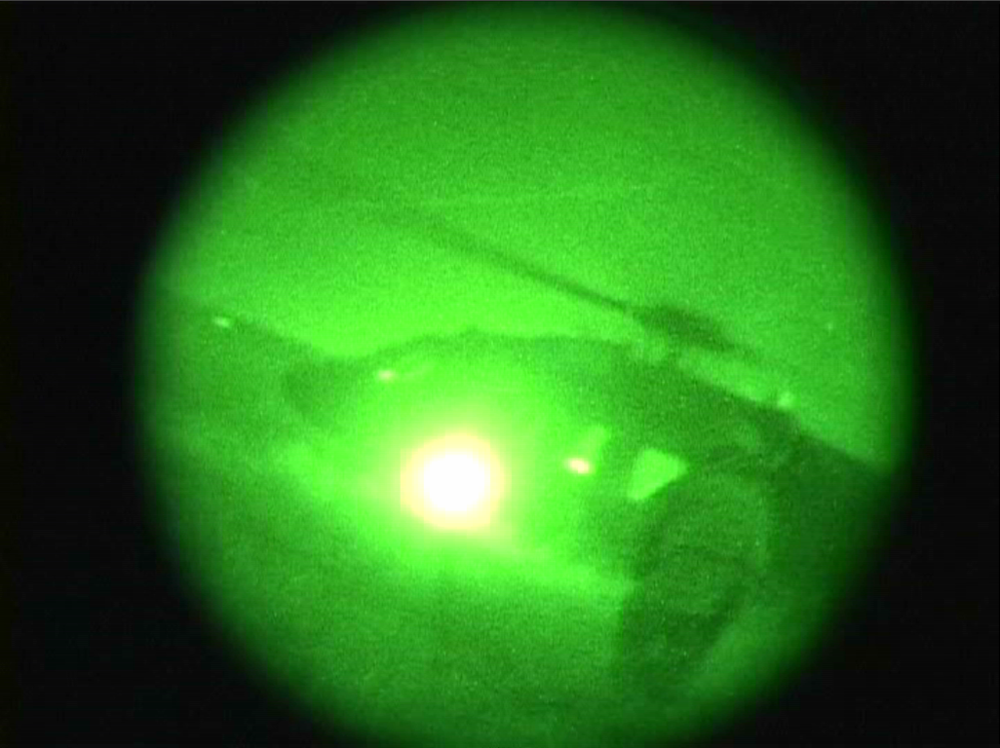
IRAQ

Slide 40
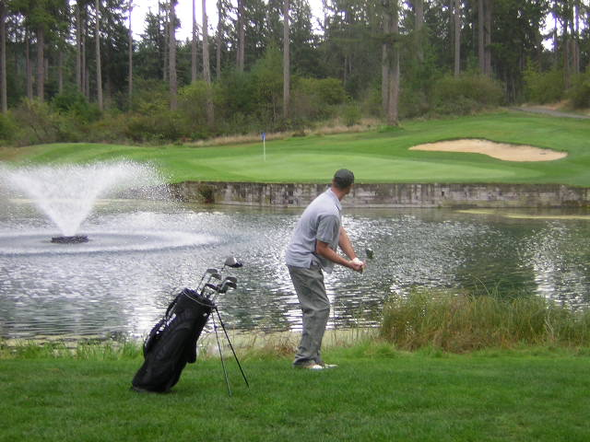
BACK TO WASHINGTON

Slide 41
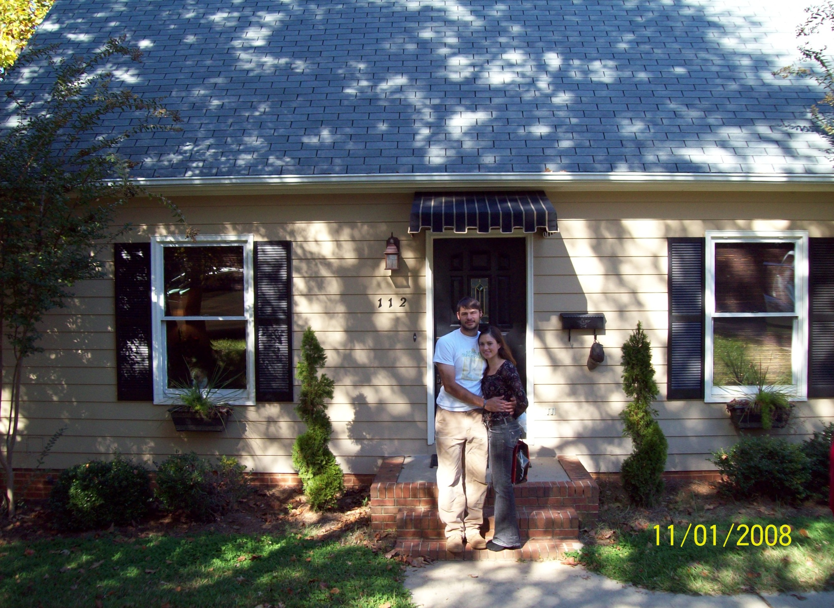
MOVE HOME

Slide 47
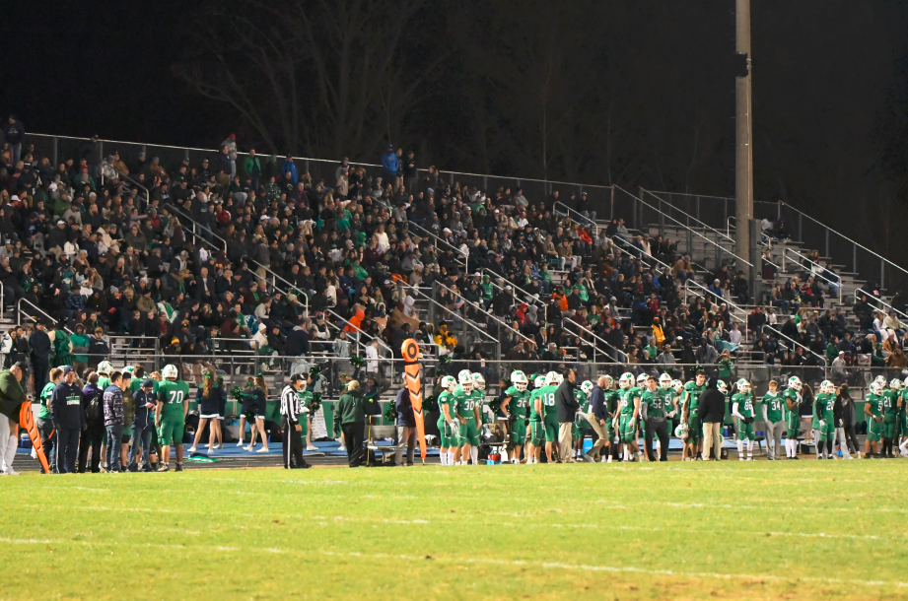

Slide 48
Quarantine

Slide 49
How was your Covid break? Anything ?
2. Something about yourself most people don’t know or anything you feel like saying about yourself.
3. Favorite teacher and why…

Slide 50
Interpretation. ...
Comparison. ...
Contextualization. ...
Synthesis. ...
Causation. ...
Patterns of Continuity and Change Over Time. ...
Periodization….

