Slide 1

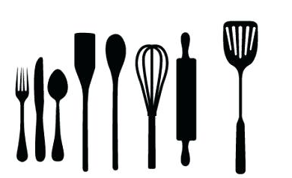


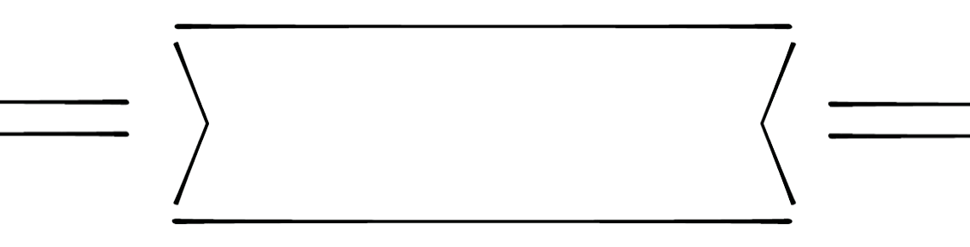

Food &
Mrs. Carolyn Hoobler
Room #301
704-764-2900 ext. 3381
Carolyn.Hoobler@ucps.k12.nc.us
Class website – on Canvas
Fall
2019
Nutrition 1
welcome
to
Food &
Nutrition1
In this class you will study individual nutritional needs, the basics of food production, kitchen and meal management, food groups and their preparation, and time and resource management. We will focus & model our classroom procedures around the workplace, explore careers in the food industry and beyond as well as important workplace and teamwork skills. Family, Career & Community Leaders of America (FCCLA) competitive events, community service, and leadership activities give opportunity to apply essential standards and workplace readiness skills through authentic experiences.
Per school policy cell phones must remain OFF and OUT OF SIGHT during class.
You may use your cellphone prior to 8:15 AM, during lunch, and after the final bell at the end of the day. NOT during class.
The rule regarding cellphones being turned off during instructional time will be strictly enforced unless the teacher has allowed them for class activities.
expectations
cell phone policy
be on time
bring your pencil and notebook
help with clean up daily
(even if it’s not your mess!)
respect yourself, your peers
(this includes opinions and property!)
and school staff & property
take responsibility for your own learning
ie. ask for help when you don’t understand,
stay focused during worktime given

Slide 2



grades
Grades & how they’re weighted
PARTICIPATION & NOTEBOOK
Do you put forth a consistent, solid effort in class? Do you keep your eyes open & your head off your desk? Do you complete class notebook assignments on time? If you miss class time you will be required to make it up to receive credit.
20%
SUMMATIVE/FORMATIVE
Throughout the course you will be given homework, readings and notes to complete.
Before each activity you will be given a rubric or criteria for the specific assignment.
Tests and quizzes will be at the end of teach unit.
*Your final exam will be 25% of your final course grade.
60%
CLASSWORK
TESTS/QUIZZES
LAB/PRODUCTION
DO YOU TAKE RESPONSIBILITY TO COMPLETE YOUR PROJECTS AND LABS
ON TIME?
EVERY LAB IS EVALUATED BASED ON THE FOLLOWING:
20%
PROJECTS
LABS
mis en place
safety and sanitation
teamwork
final product
specific criteria for the project
commonly asked questions
What if I’m absent?
Do I lose points for
late work?
I’m not the best cook...
will I struggle?
It is the student’s responsibility to check the class website and also with the teacher to find out what assignments need to be made up. Students have 5 days to turn in any make-up work (tests, quizzes etc.) or they will not get credit for it.
The question, I’m afraid is a wrong
one. Culinary skill is learned, not
inherited (& science will back me up). No one enters a math class expecting to receive a grade for what they already know & an ‘F’ if they don’t understand the next semester’s worth of material they haven’t yet heard about! You will be fine!
Yes. Each homework assignment or project will come with a due date. It is your responsibility to keep track of that due date in your planner. Your assignment value will be reduced by 25% for each day late. Make sure you turn your work in on time!

Slide 3

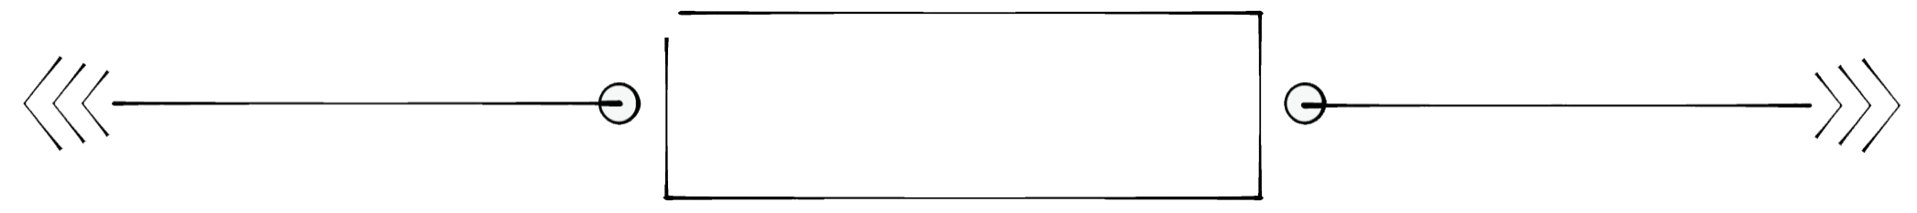
units
study
OF
FN41 |  | Food & Nutrition 1 (2018-2019)
Objective | 1 | Understand the relationship between food choices and health.
 | 1.01 | Remember influences on food choices.
 | 1.02 | Understand guidelines for healthful food preparation.
Objective | 2 | Understand fundamentals of food preparation.
 | 2.01 | Understand kitchen safety.
 | 2.02 | Understand safe food handling procedures.
 | 2.03 | Remember equipment and procedures for its use and care.
 | 2.04 | Remember measuring, cutting/preparation, mixing, and cooking/cleaning terms.
 | 2.05 | Remember recipe parts, sources, and adjustments.
 | 2.06 | Understand processes and benefits of a work plan and teamwork for preparing healthy foods.
Objective | 3 | Understand procedures, nutrition, and cooking methods in food preparation.
 | 3.01 | Understand procedures, nutrition, and cooking methods in fruit and vegetable preparation.
 | 3.02 | Understand procedures, nutrition, and cooking methods in dairy preparation.
 | 3.03 | Understand procedures, nutrition, and cooking methods in grain preparation.
 | 3.04 | Understand procedures, nutrition, and cooking methods in protein preparation.
Objective | 4 | Understand procedures, equipment, and techniques applied to baking production.
 | 4.01 | Understand procedures to prepare quick bread products.
 | 4.02 | Understand procedures to prepare yeast bread products.
 | 4.03 | Understand procedures to prepare cakes and frostings. (SUPPLEMENTAL)
Objective | 5 | Understand the principles of etiquette for meal service.
 | 5.01 | Understand the principles of basic table setting and meal service.
 | 5.02 | Understand the principles of table manners.
Objective | 6 | Apply methods for meal planning and preparation.
 | 6.01 | Understand strategies in meal planning.
 | 6.02 | Understand strategies for purchasing food.
 | 6.03 | Apply methods to prepare healthy meals.
signature
Share this syllabus with your parents and let them know what you’ll be up to this year, and return
with your parent or guardian’s signature as well as your own for extra credit. It’s important to
include your family in your education to ensure you get the help, reminders, and support you need
to succeed.
your signature
your parent/guardian’s signature

