Slide 1
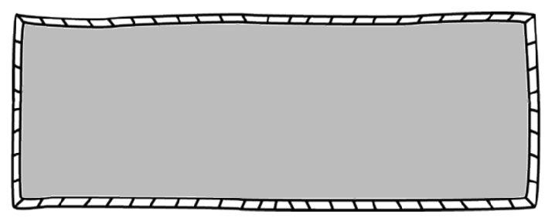
Unit Topics
Math 3
Supply List
3-ring Notebook/Paper
Graphing Calculator TI84Plus
Pencils/Pens
Expo marker/highlighter
Wish List: Tissues & 3As
Functions
Exponential & Log Functions
Polynomial Functions
Rational Functions
Modeling with Geometry
Circles
Trig Graphs & Statistics
Mrs. Brandon Griffith
NEED EXTRA HELP?? The math department will offer tutoring on Tuesday and Thursday afternoons 3:30 – 4:00.
The schedule will be posted on my door.
Contact Info
brandon.griffith@ucps.k12.nc.us
704-753-2810
1. Come to class on time, prepared, and ready to learn.
2. Do not interrupt class instruction.
3. Participate in all class activities.
4. Respect yourself, others, and property.
LOG IT Notebook
Students are responsible for taking teacher specified notes each day. If a student is absent, he/she is responsible for making up missed notes.
Grades will be calculated on the points system and will consist of tests, quizzes, and assignments. Homework will be assigned daily.
Graphing Calculator
Each student should have their own TI-84 Plus calculator. Please let me know if there is a financial concern so other arrangements can be made.
Students will take a Final Exam.
All cell phones and devices MUST be put away during instruction and quizzes/tests.
Believe you can and you’re halfway there.
Theodore Roosevelt
Assignments and resources will be located on CANVAS.

Slide 2
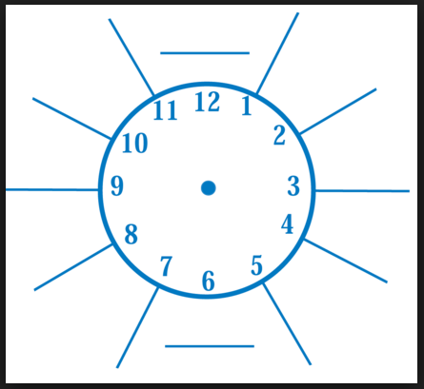
Math 3 – Griffith
Student Name: __________________________
I have read and understand the course guide.
_________________________________
Student Signature
_________________________________
Parent/Guardian Signature
PROGRESS REPORTS
Student grades may be viewed on student ‘s Chromebooks at any time. I will ask students to show their parent or guardian their grades each six weeks and sign here.
1st 6 weeks average: _____
Parent Signature _______________
2nd 6 week average: _____
Parent Signature _______________
3rd 6 week average: _____
Parent Signature _______________
Life is what we make it. Always has been, always will be. ~ Grandma Moses

