Slide 1
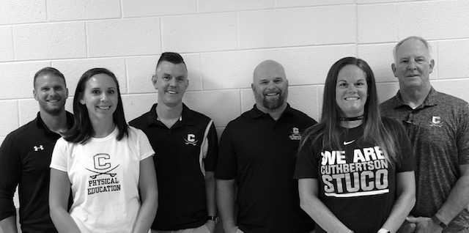
CUTHBERTSON MIDDLE SCHOOL HEALTH AND PHYSICAL EDUCATION DEPARTMENT
Featuring:
Ms. Lasher, Mr. Guylitto, Mr. Markley
Ms. Palmer, Mr. Harris, Mr. Polley

Slide 2
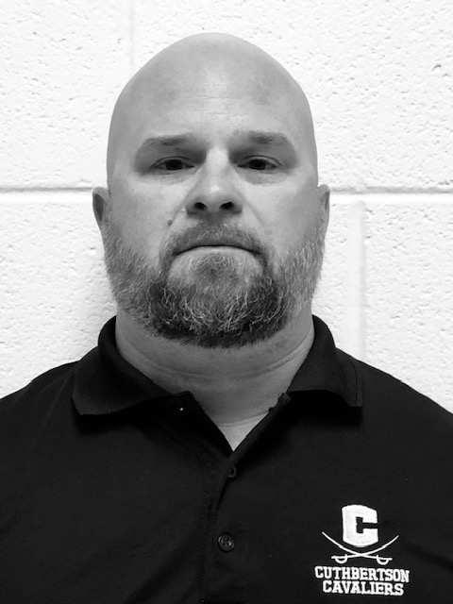
Hank Harris
Band PE- 8th grade
PE-
7th and 6th grade

Slide 3
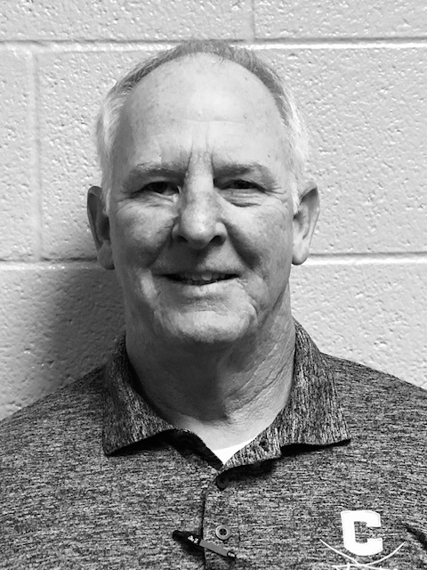
Tony Guylitto
Health Education-8,7,6

Slide 4
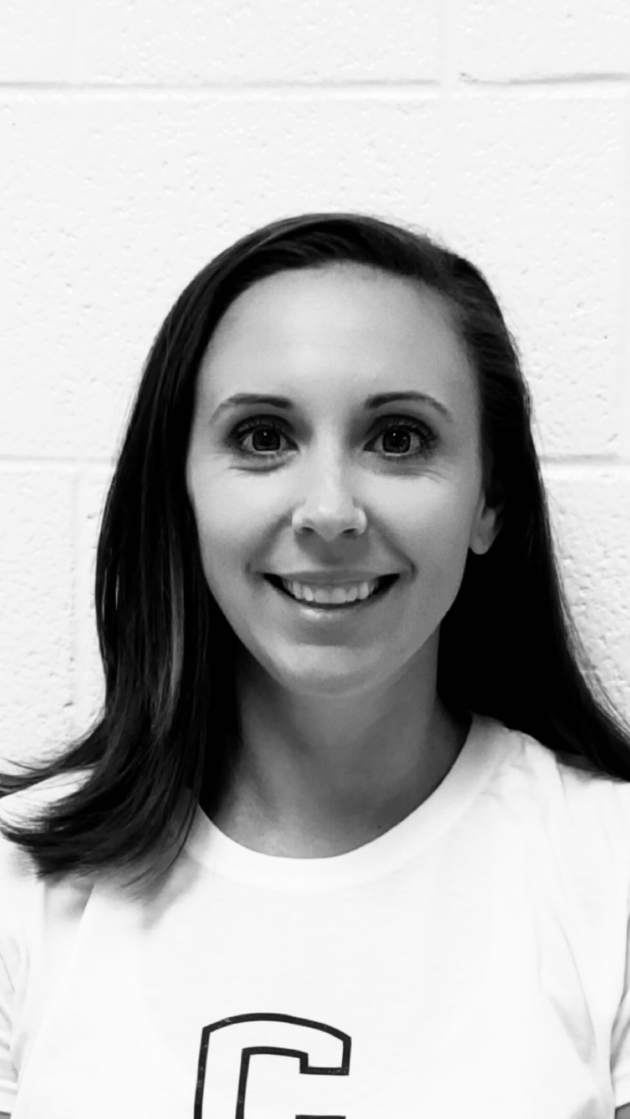
Brittany Lasher
PE-8,7,6

Slide 5
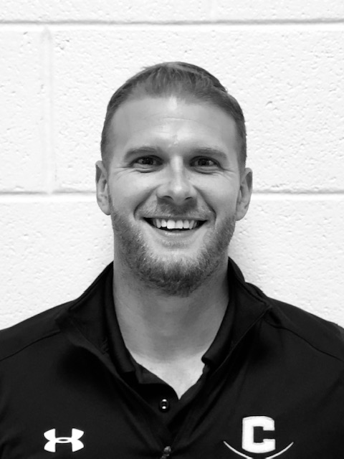
Kyle Markley
PE and FitLab-8,7,6
Boys Basketball coach

Slide 6
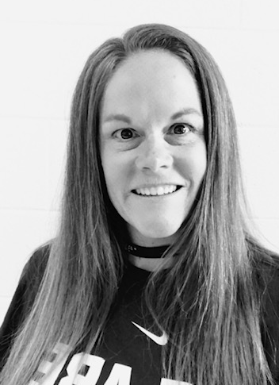
Tess Palmer
PE- 8,7,6
Athletic Director

Slide 7
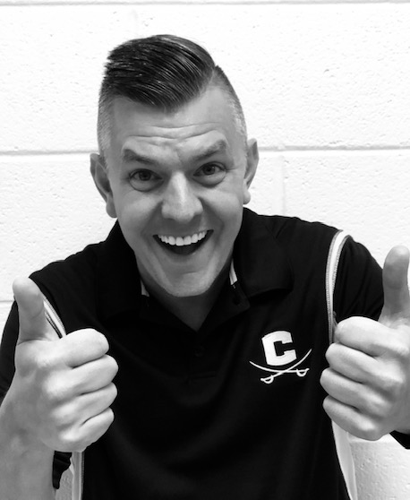
Justin Polley
PE and FitLab-8,7,6

Slide 8
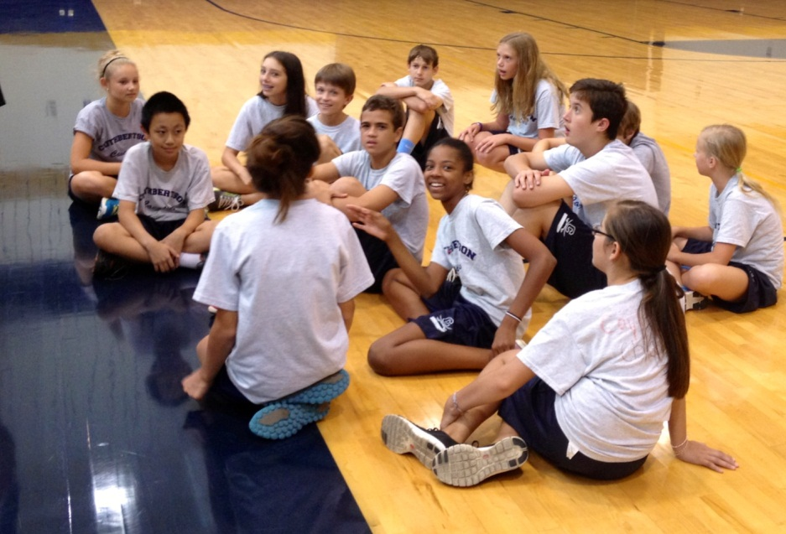
Classes your child will take this year
Health (6 weeks)
Computers (6 weeks)
FIT Lab (6 weeks)
Physical Education (18 weeks)

Slide 9
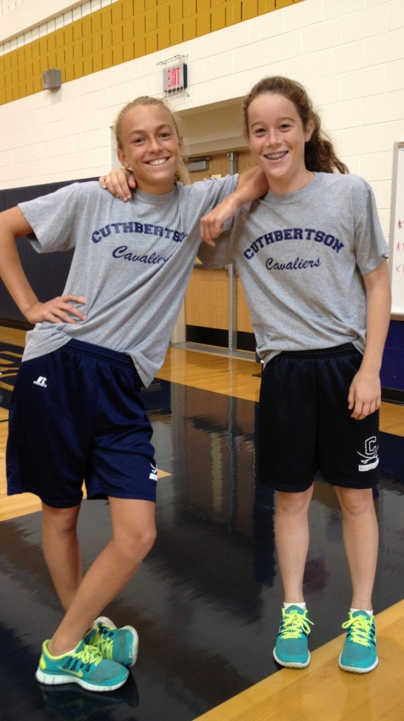
Expectations
Your child needs to be dressed out and participating to be successful in our classes.
Dressed out means they have changed out of their street clothes and put on a Cuthbertson PE shirt and Cuthbertson PE shorts; there are also SNEAKERS on their feet!
Participating means following directions and doing activities to their best ability!

Slide 10
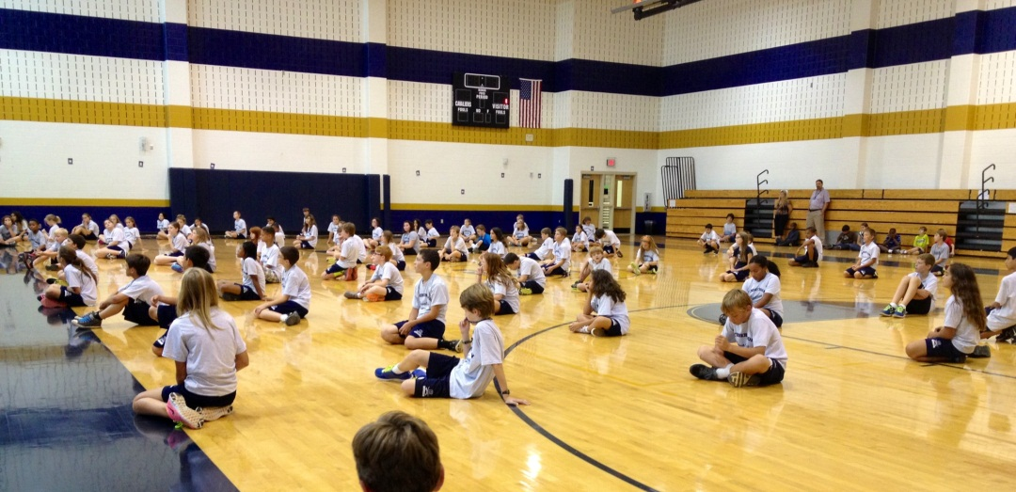
Students are graded based upon:
Participation (40%)
Preparation (20%)
PACER test (20%)
Exercise Log (10%)
Quiz (10%)
This will be explained to your student on the first day of school and will sent home to be signed and returned by parent/guardian.

Slide 11
Parent and Doctor Notes
A parent note may excuse your child from participation, but not from dressing out in PE clothes. After 2 days, it is expected that the student will get a doctors note. Our students must be ACTIVELY engaged to be successful in our class.
A doctors note excuses a student from physical activity according to a doctors diagnosis. Student will dress or not dress out due to doctors instruction.

Slide 12
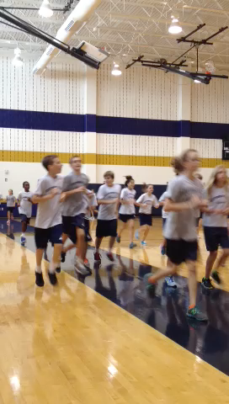
A typical day in the gym…
A 10 minute jog (broken into increments).
Click image to watch our warm up run in motion!

Slide 13
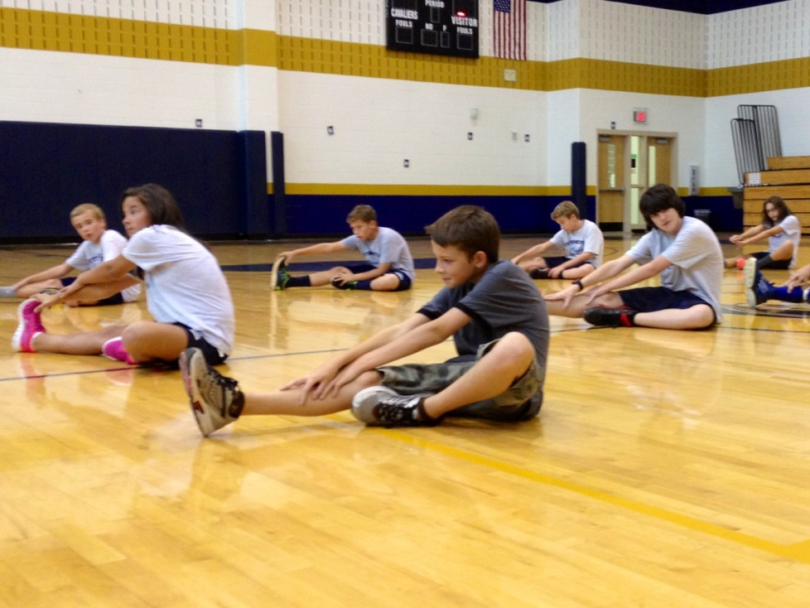
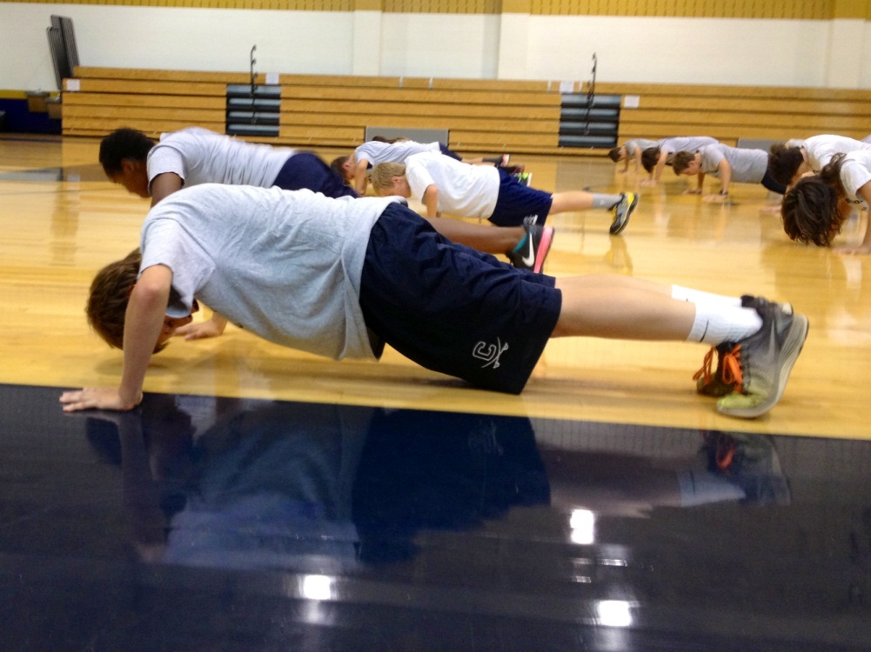
Stretching/Strengthening
Students work through a set of 10 exercises
that help with stretching and strengthening
their muscles.

Slide 14
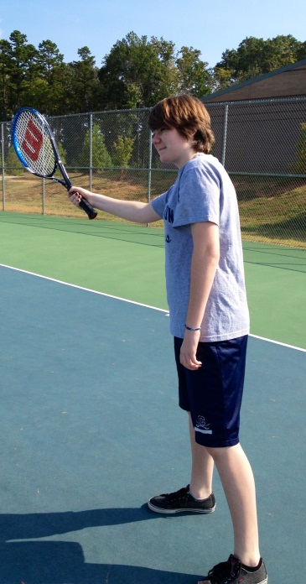
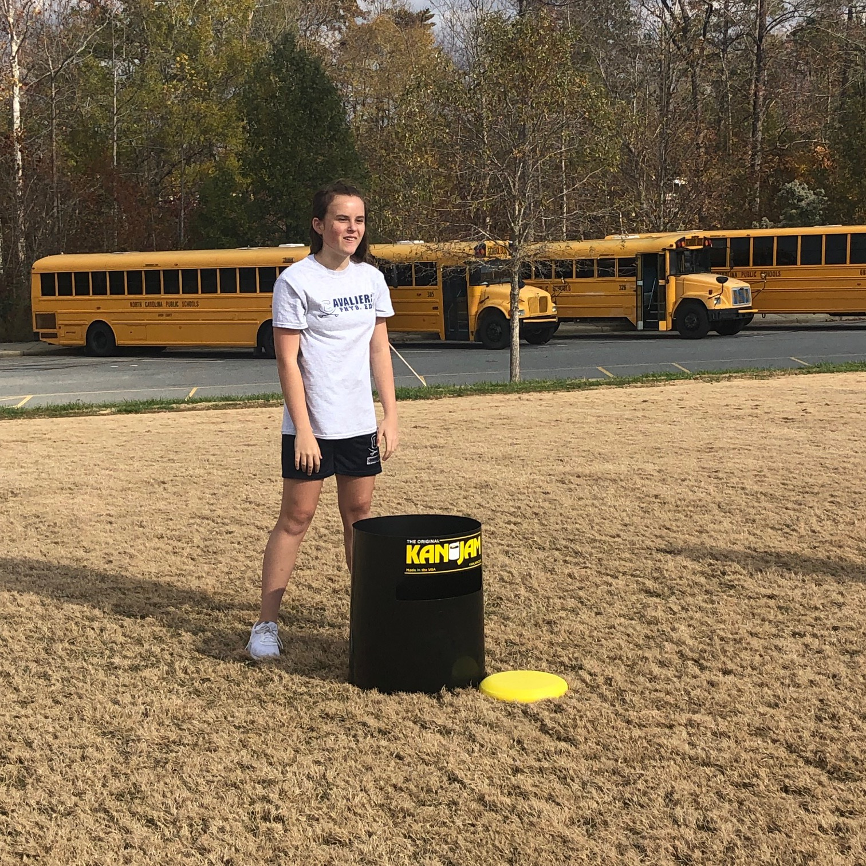
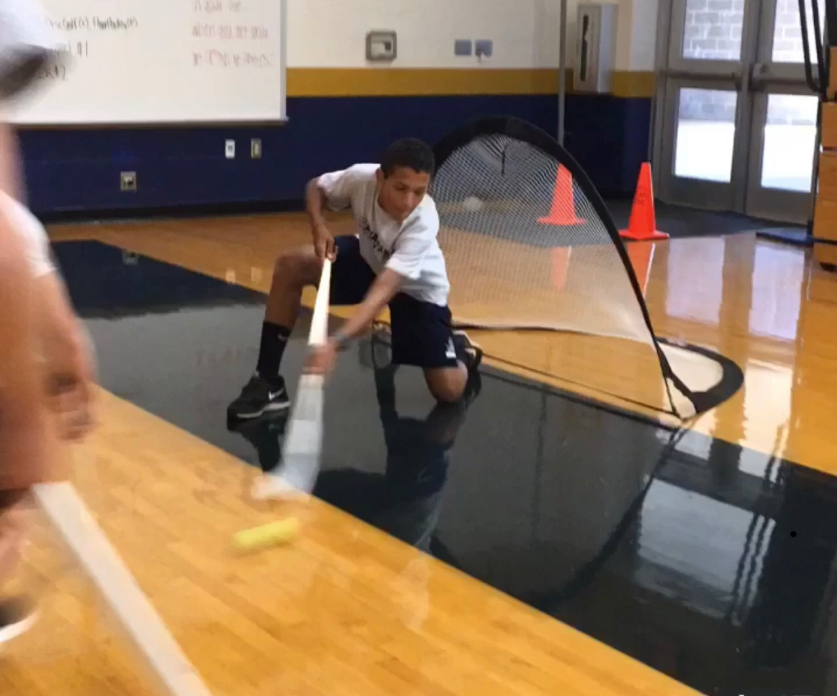
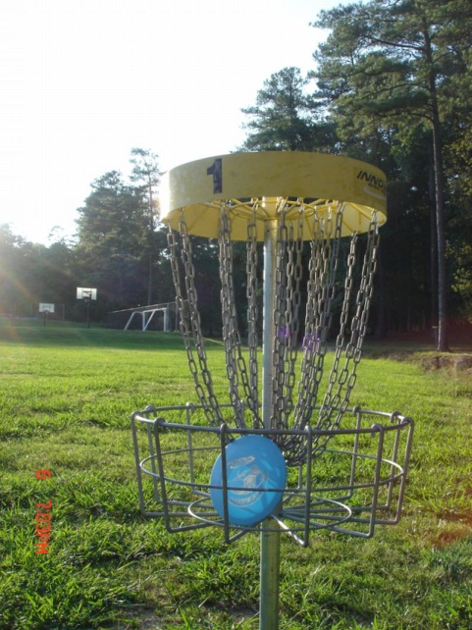
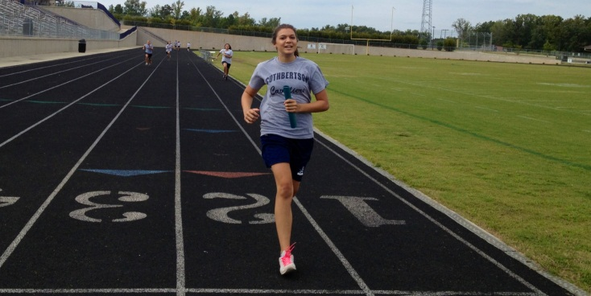
Units of Study in 7th/8th grade PE
Track and Field (7)
Disc Golf
Tennis (8)
Archery(8)
Bowling
Volleyball
Floor Hockey (8)
Golf (8)
Pickle Ball (7)
Ultimate games (7)
Backyard BBQ (8)

Slide 15
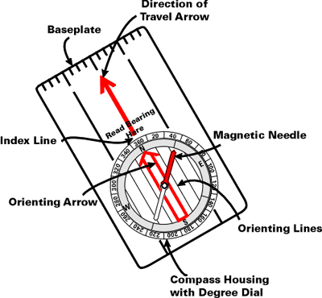
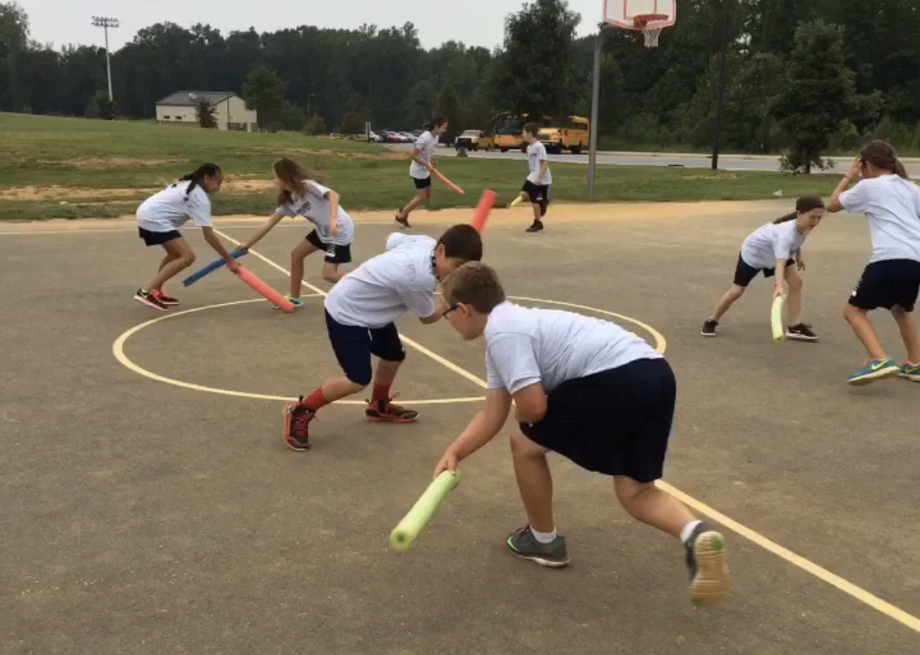
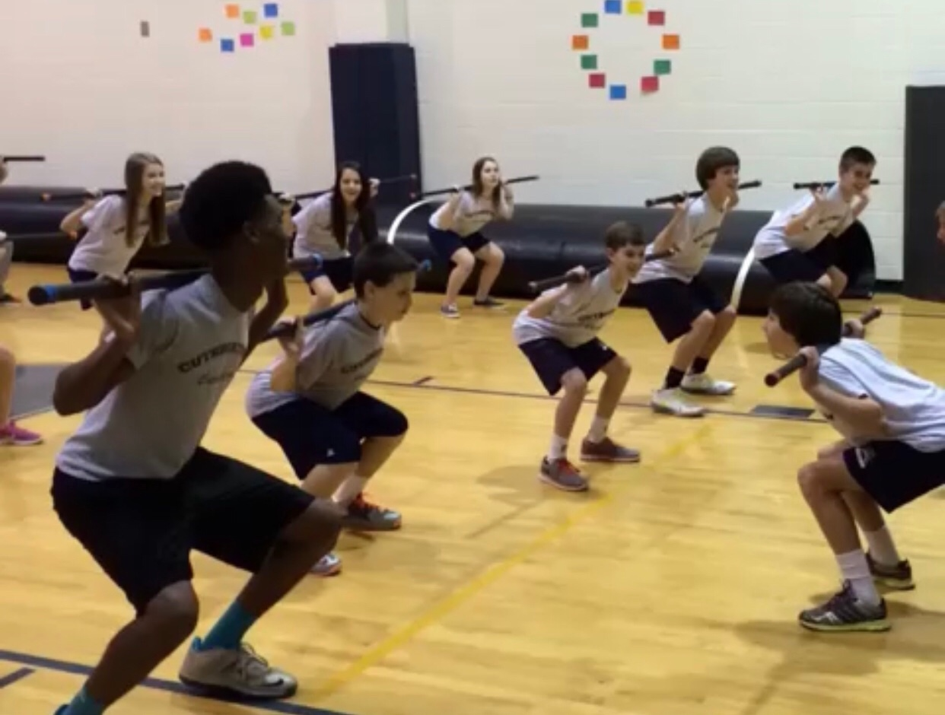
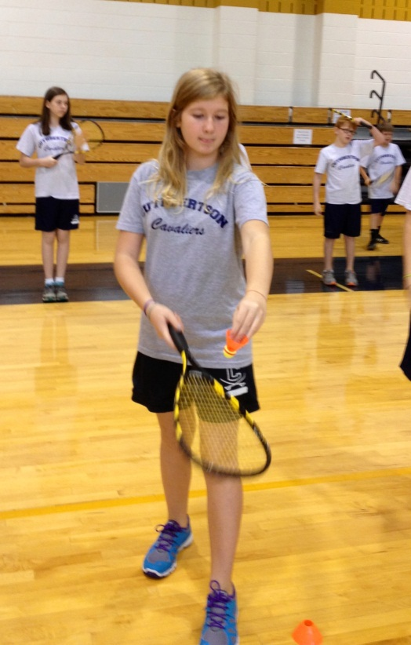
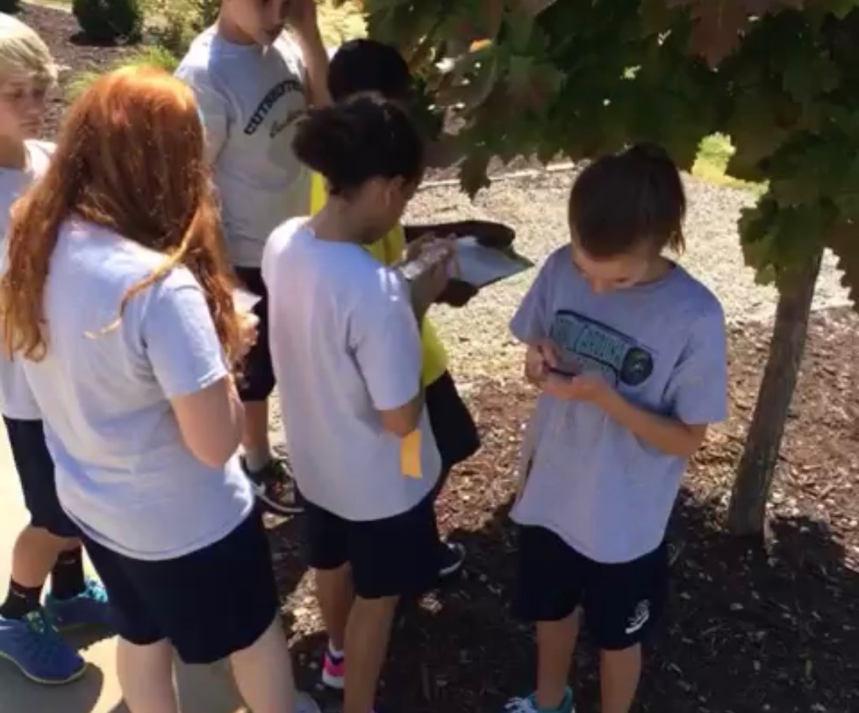
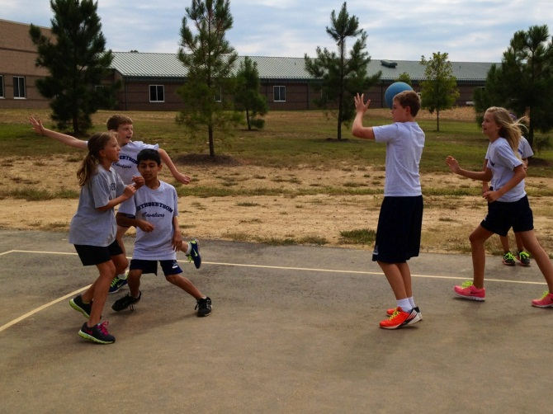
Units of study for 6th grade
Group Fitness
Badminton
Disc Golf
Orienteering
Volleyball
Dance
Jump Rope
Outdoor games

Slide 16
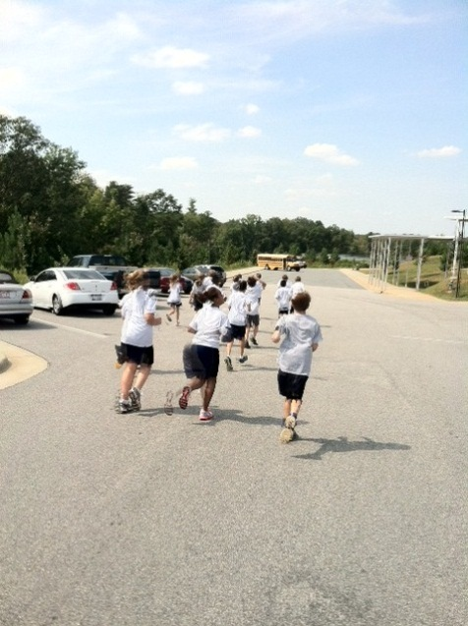
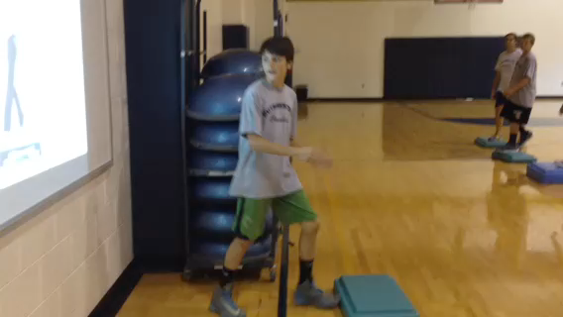
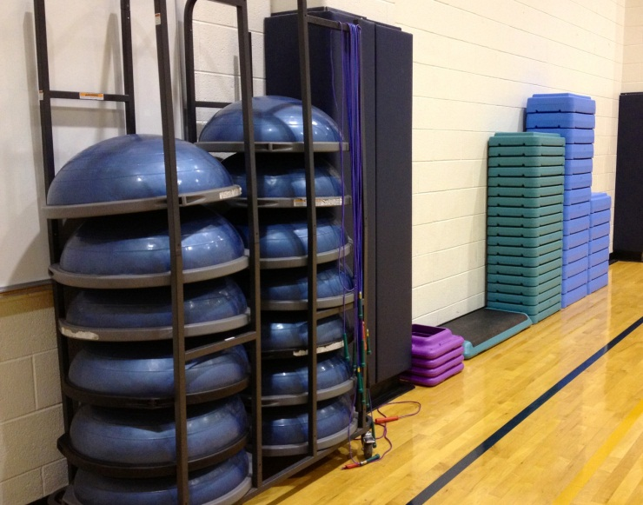
Group Fitness
Click image below to watch our 7th graders step it out!!

Slide 17
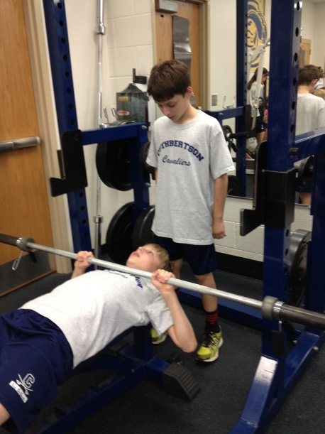
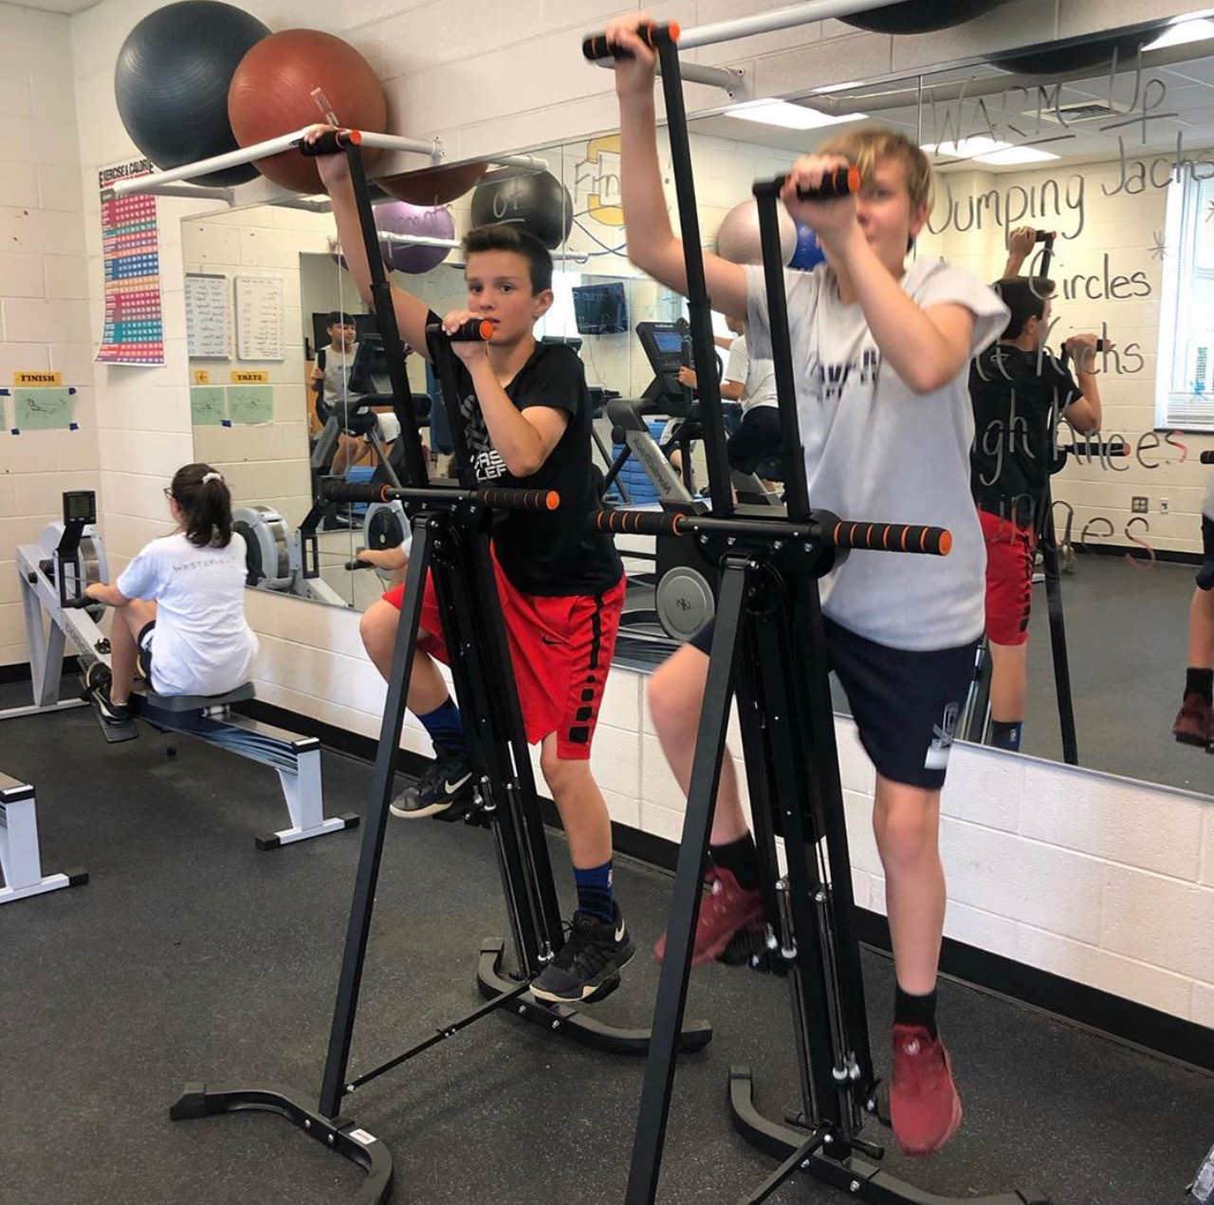
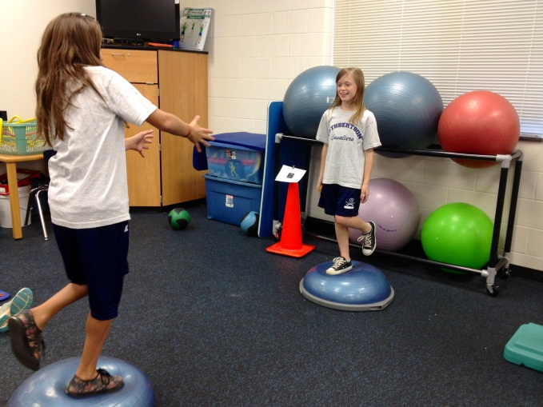
FIT Lab with Mr. Markley (8,6) and Mr. Polley (7)

Slide 18
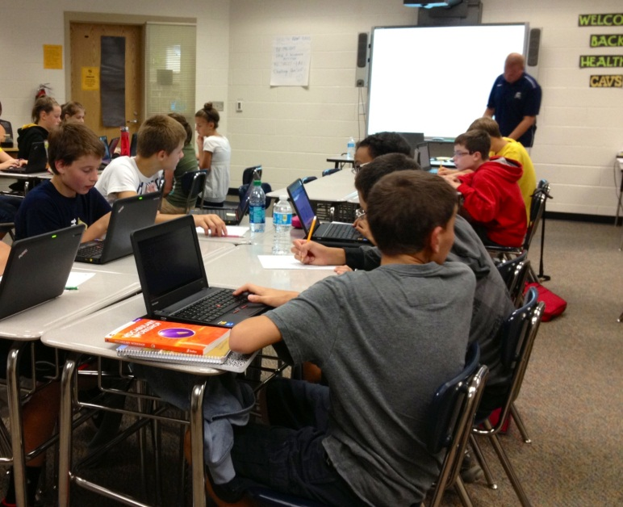
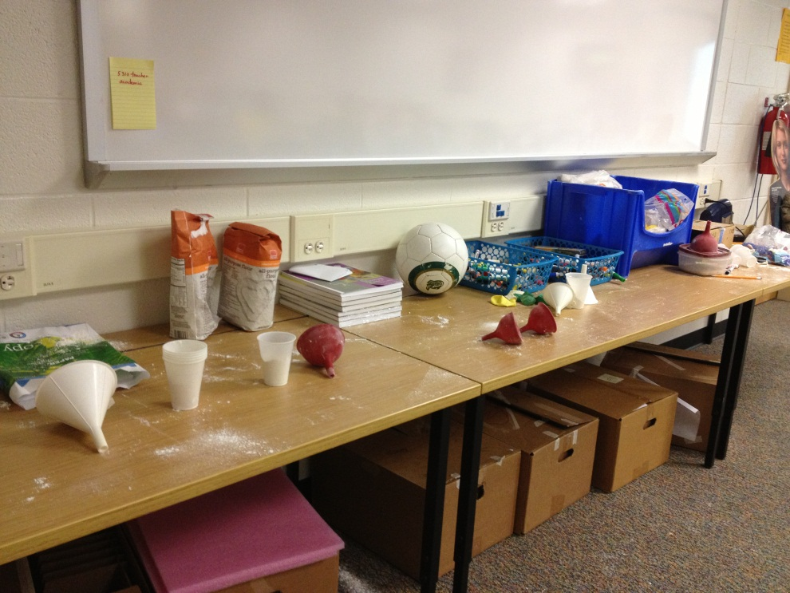
Health Education Mr. Guylitto (6,7,8)
Mr. Harris (7,8 Band)

Slide 19
Check out our google site

Slide 20
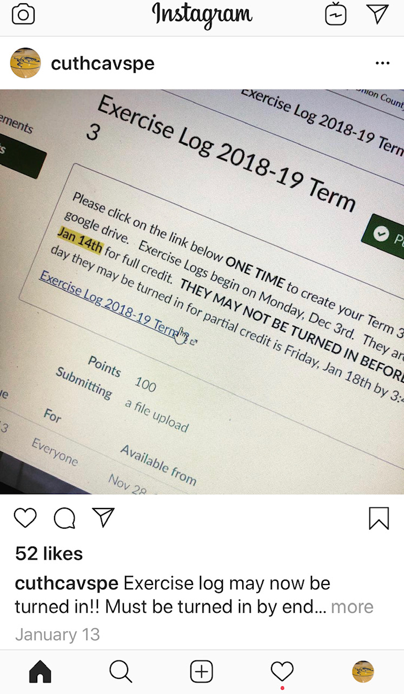
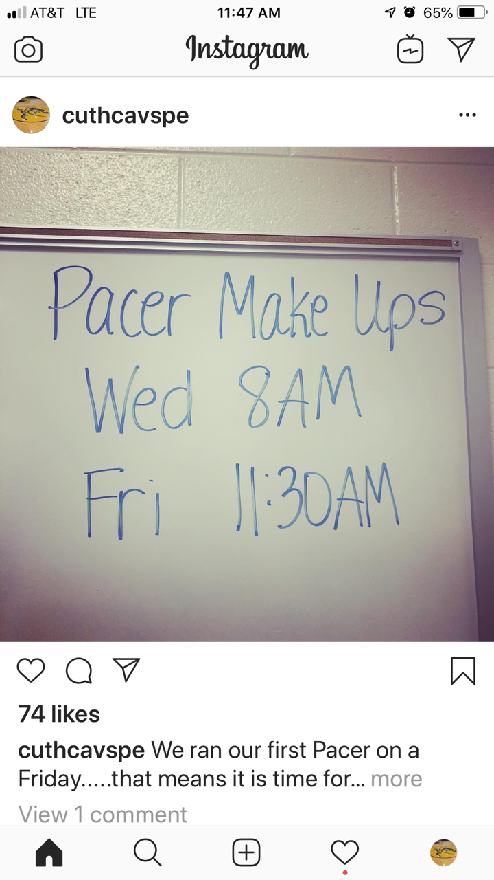
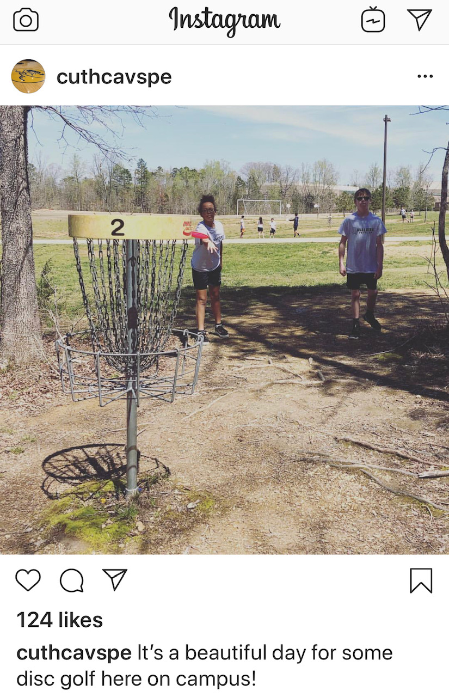
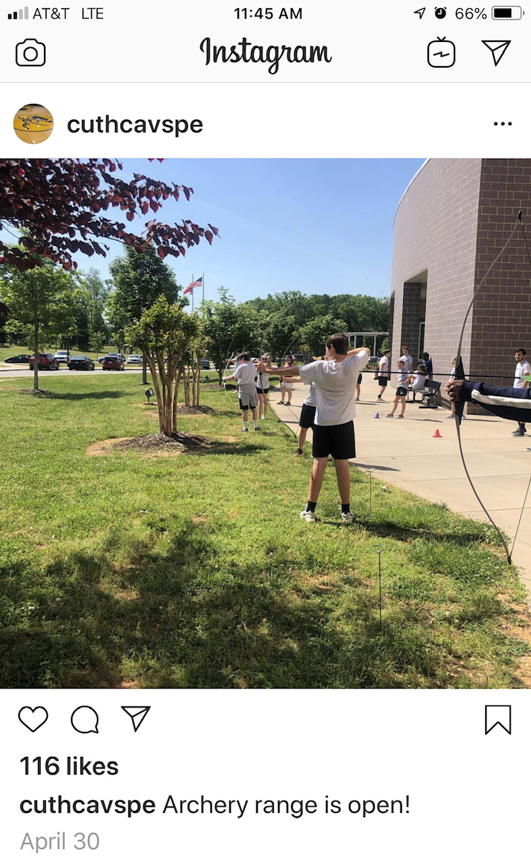
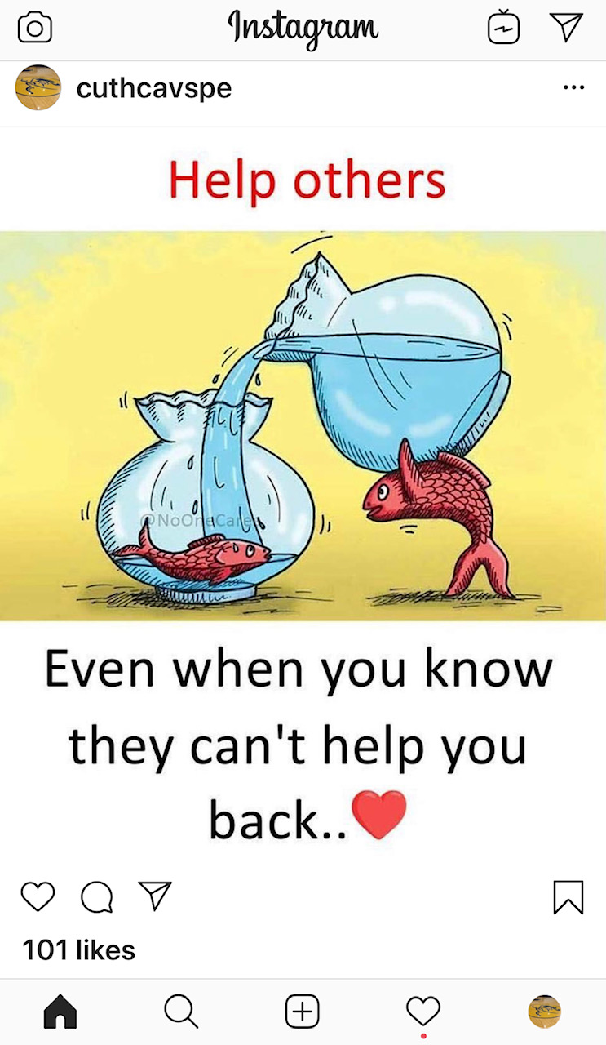
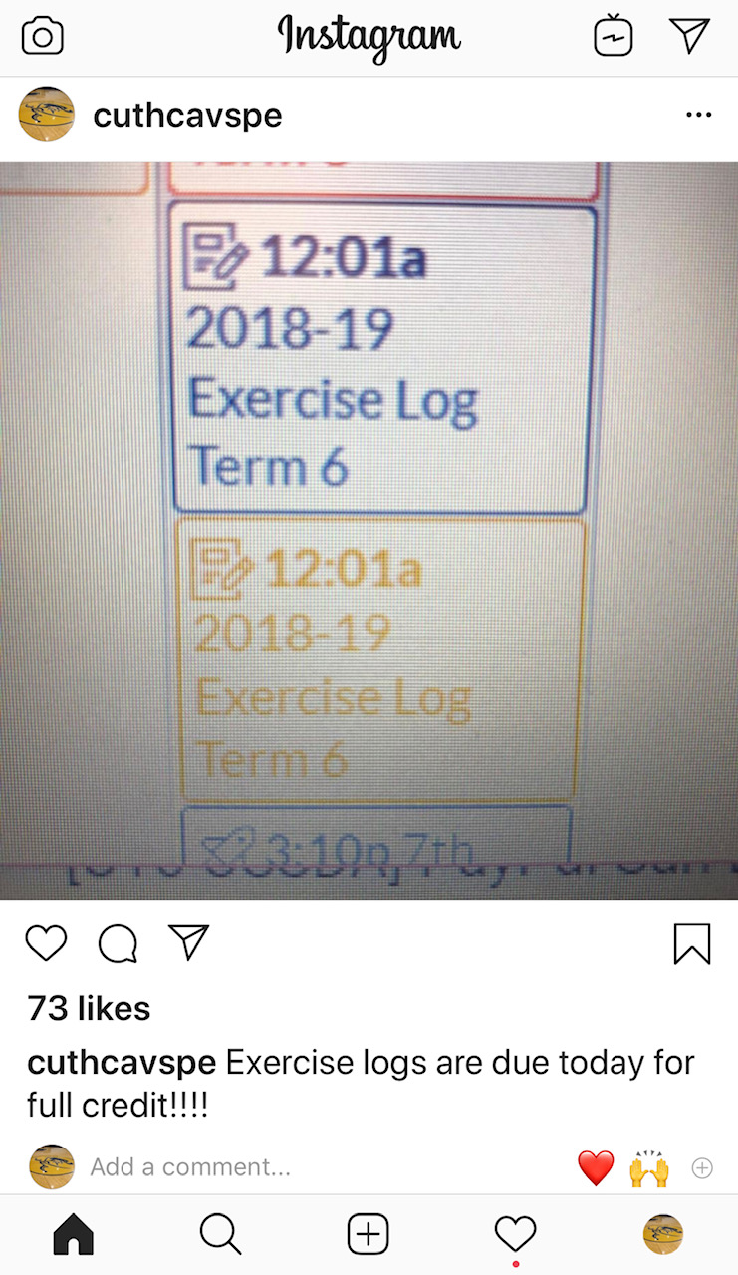
Follow us on Instagram
CuthCavsPE

Slide 21
@CuthbertsonPE

