Slide 1
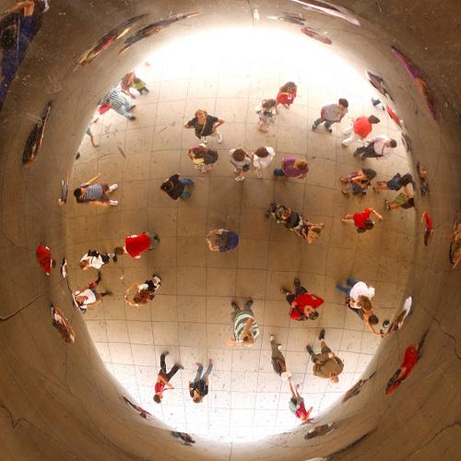
Social Studies Terminology
*photos from Photos for Class
Social Studies

Slide 2
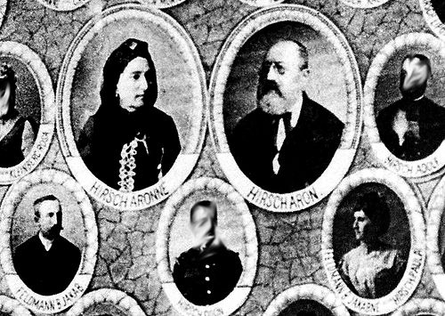
ANCESTOR
...a person from whom another is directly related.

Slide 3
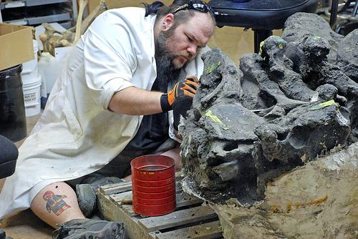
Archaeologist
...the scientific study of prehistoric peoples and their cultures by analysis of their artifacts, inscriptions, monuments, etc.

Slide 4
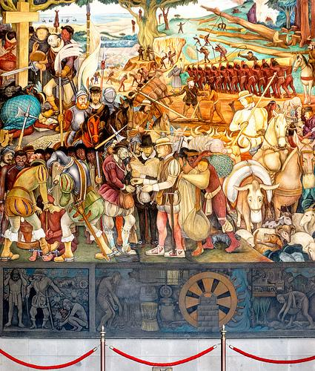
Conquistadors-a conqueror, especially one of the Spanish conquerors of Mexico and Peru in the 16th century..

Slide 5
CULTURE (elements of)
Culture is everything that makes up someone’s way of life:
http://www.slideshare.net/apersone/7-elements-of-culture
There are seven “elements of culture”:
*social organizations *customs and traditions
*religion *arts and literature
*government *economy
*common language

Slide 6
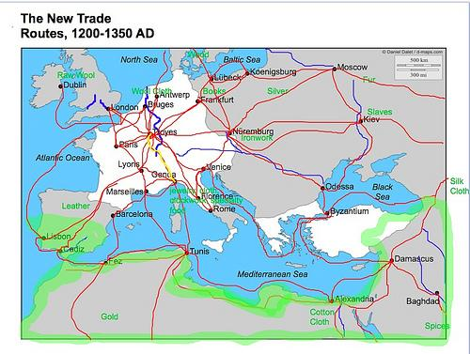
Cultural Diffusion
...the process by which ideas and beliefs from one culture spread into another culture; the mixing of culture

Slide 7
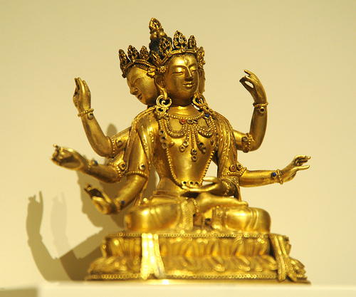
DEITY
...a god or goddess (in a polytheistic religion).: "synonyms:
god, goddess,divine being, immortal

Slide 8
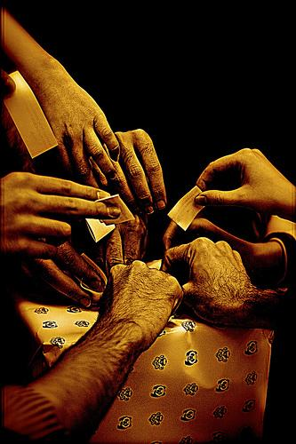
DEMOCRACY
… government by the people; a form of government in which the supreme power is vested in the people and exercised directly by them or by their elected agents under a free electoral system; representative government.

Slide 9
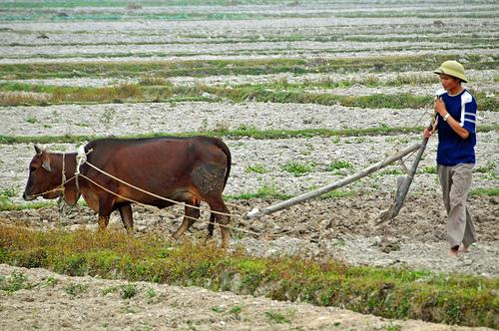
Domestication
...the process of training an animal for a specific use; for domestic or home purposes; to use for the advantage of humans

Slide 10
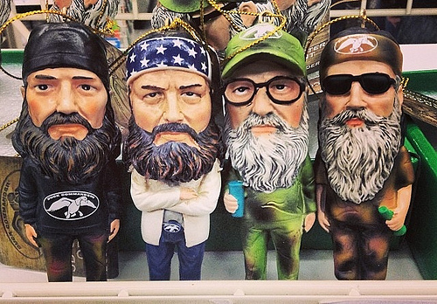
DYNASTY
….a line of hereditary rulers of a country; bloodline, ancestry, descent, succession, genealogy, family tree.

Slide 11
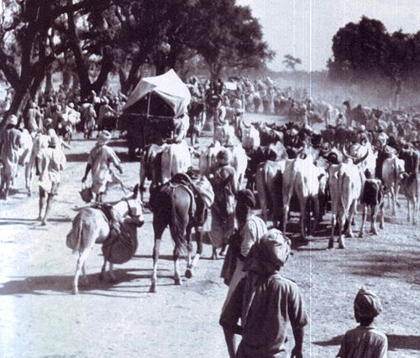
Exodus
….a mass departure; the Israelites experienced a mass “leaving” from Egypt, as they were freed from slavery

Slide 12
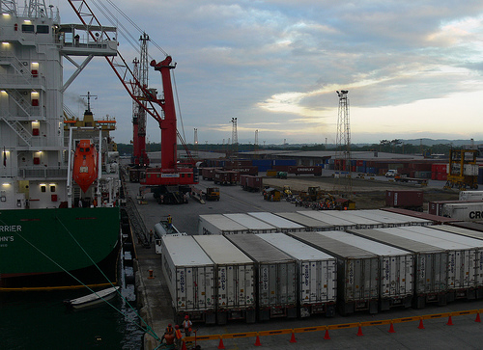
Export vs Import
Export- to carry or send to another country or place for the purposes of sale or trade
Import- to bring in or introduce from a foreign country

Slide 13
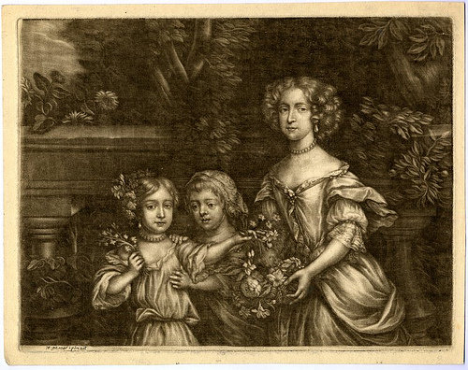
HEIR
...offspring; a person who inherits or has a right of inheritance of property in another’s death.

Slide 14
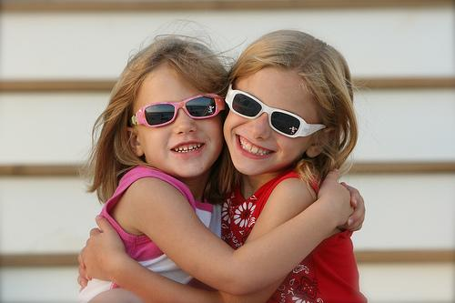
HUMAN NATURE
...ordinary human behavior; the unique elements that form a basic part of human life and distinguish it from other animal life

Slide 15
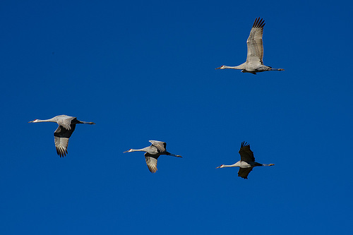
Immigrate, Migrate
Immigrate- to enter or come into a country of which one is not native, to become a permanent resident (immigrant)
Migrate- to move from one country, location, climate, or place to another

Slide 16
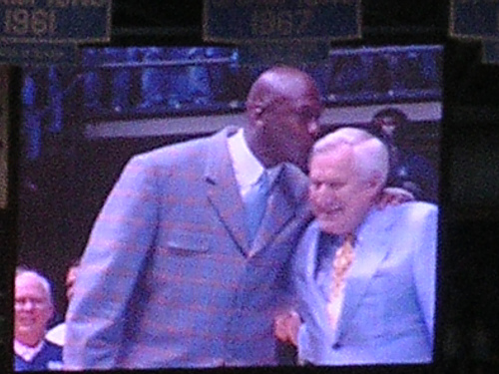
LEGACY
...a gift by will, especially of money or personal property; something handed down or received from an ancestor or predecessor; what someone leaves to the generations that come after them, their accomplishments;
someone’s LIFE HISTORY.

Slide 17
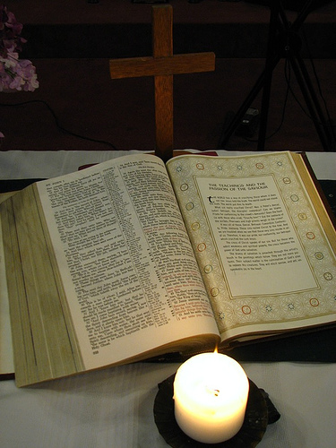
Monotheistic vs Polytheistic
Monotheistic- the belief in ONE God or creator
Polytheistic- the belief in MANY gods or goddesses

Slide 18
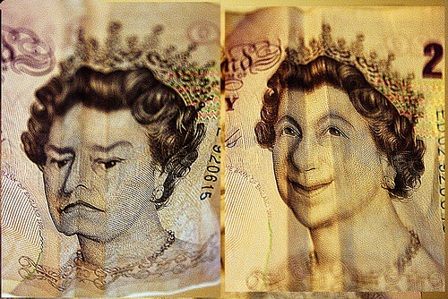
MONARCHY
a form of government in which supreme authority is vested in a single figure, such as a king, and whose powers can vary from those of absolute to those of a figurehead; a country reigned over by a king, prince, or other monarch

Slide 19
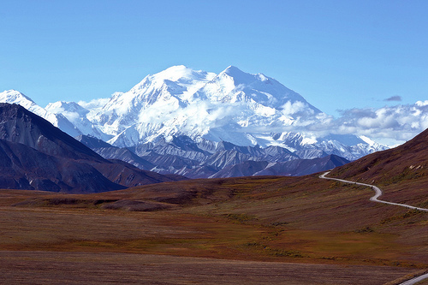
Natural Barriers
….natural landforms or bodies of water that make travel difficult. Natural barriers can provide protection from invaders or can keep a civilization from being able to travel, trade, or escape. They include mountains, deserts, oceans and rivers.

Slide 20
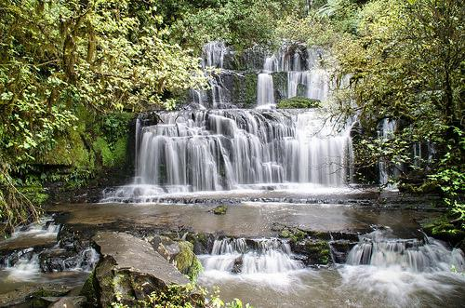
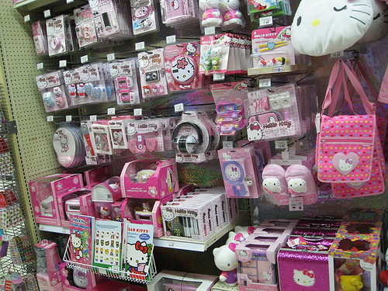
Natural Resources and Merchandise
.
Natural resources and commercial goods; commodities

Slide 21
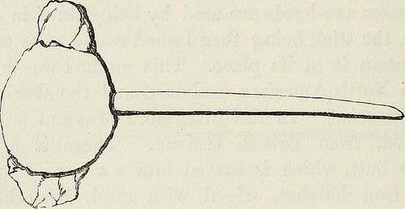
Neolithic...Paleolithic time periods...
Neolithic- the lastest (last) period of the Stone Age, characterized by polished stone implements
Paleolithic- the second period of the Stone Age, characterized by rough or crudely chipped stone implements

Slide 22
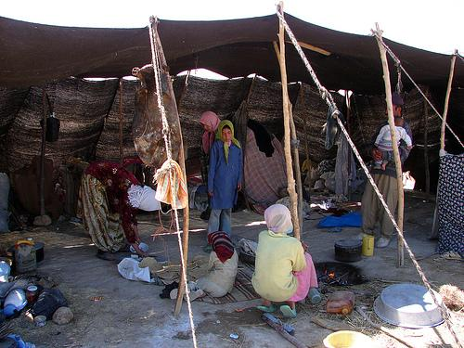
Nomad; nomadic herder-
a member of a people having no permanent abode, and who travel from place to place to find fresh pasture for their livestock

Slide 23
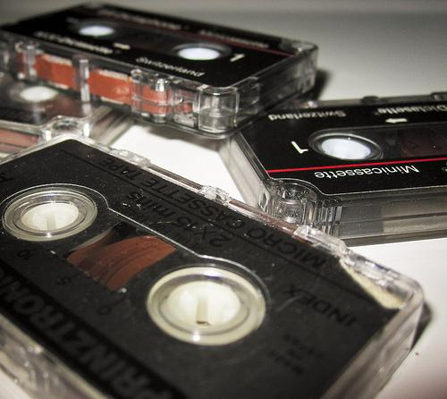
Obsolete
OBSOLETE
...old; no longer in general use; fallen into disuse:

Slide 24
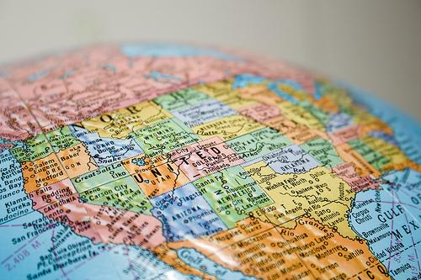
POLITICAL BOUNDARIES
...demarcation lines that separate cities, counties, states, or countries from each other. There are usually no visible, physical delineations (lines), although sometimes natural boundaries like rivers, mountain ranges or oceans will serve as guides for the political boundaries, or man-made boundaries like walls
and fences can be used.

Slide 25
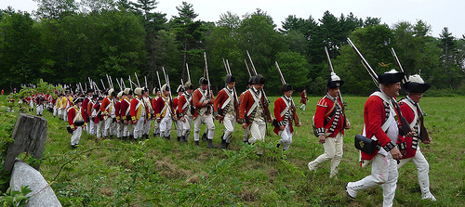
POLITICAL REBEL
...to resist or rise up against a government or other authority, especially by force of arms.

Slide 26
PRIMARY VS SECONDARY SOURCES
http://www.youtube.com/watch?v=g0plq2E9ZjQ
A primary source is a document or physical object which was written or created during the time under study. They were present during an experience or time period and offer an inside view of a particular event. Examples:
ORIGINAL DOCUMENTS (excerpts or translations acceptable): Diaries, speeches, manuscripts, letters, interviews, news film footage, autobiographies, official records
CREATIVE WORKS: Poetry, drama, novels, music, art
RELICS OR ARTIFACTS: Pottery, furniture, clothing, buildings
A secondary source interprets and analyzes primary sources. They are one or more steps removed from the event. Theymay have pictures, quotes or graphics of primary sources in them.Examples: PUBLICATIONS: Textbooks, magazine articles, histories, criticisms, commentaries, encyclopedias

Slide 27
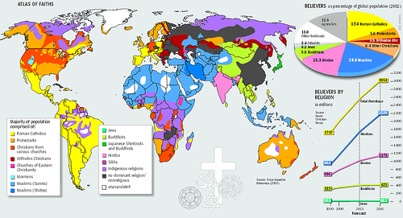
Religions of the World
https://www.google.com/search?q=major+religions+of+the+world&espv=210&es_sm=122&tbm=isch&tbo=u&source=univ&sa=X&ei=GQ4eU4qECs6gkQeN94DYDQ&ved=0CDQQsAQ&biw=80

Slide 28
Major Religions
https://docs.google.com/a/ucps.k12.nc.us/document/d/13vDd00m038wwN9Fhht4qdcQoOp8z1NISEso6DiwkVo0/edit#
Google Doc

Slide 29
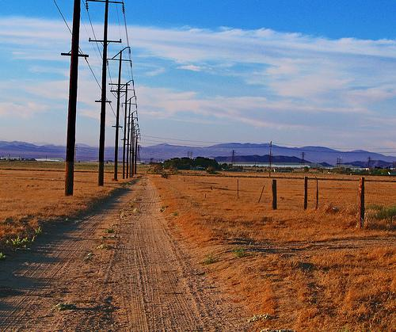
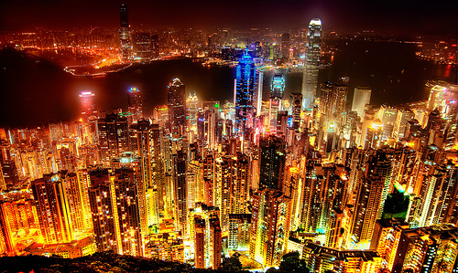
Rural vs Urban
Rural- of the country; out in
natural surroundings; away from
the city
Urban- of or in the city; towns and trade and businesses surrounding

Slide 30
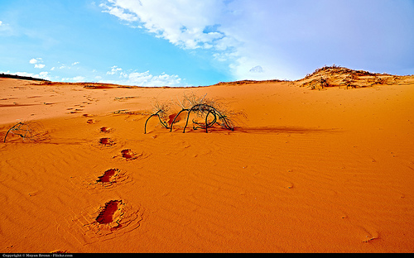
Scarcity
Scarcity ...not enough of something; needing more of a resource

Slide 31
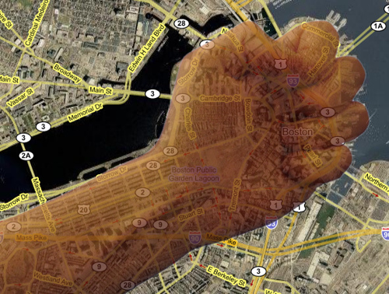
SOVEREIGN POWER
...a combination of all power; the power to do everything in a state without accountability; to make laws, to execute and to apply them: to impose and collect taxes, to make war or peace; to form treaties of alliance or of commerce with foreign nations, and the like

Slide 32
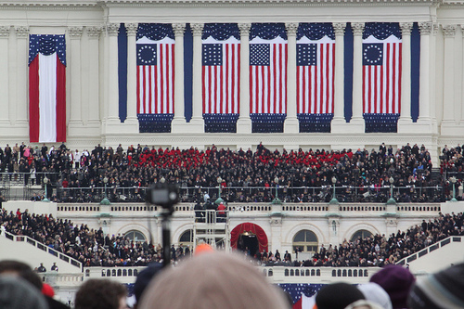
TRANSITION….OF POWER
….CHANGE of power….to transition is to change or move from one idea or event to another

Slide 33
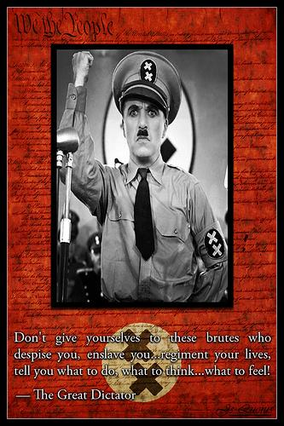
TYRANNY
cruel and oppressive government or rule; synonyms: absolute power or dictatorship

