Slide 1
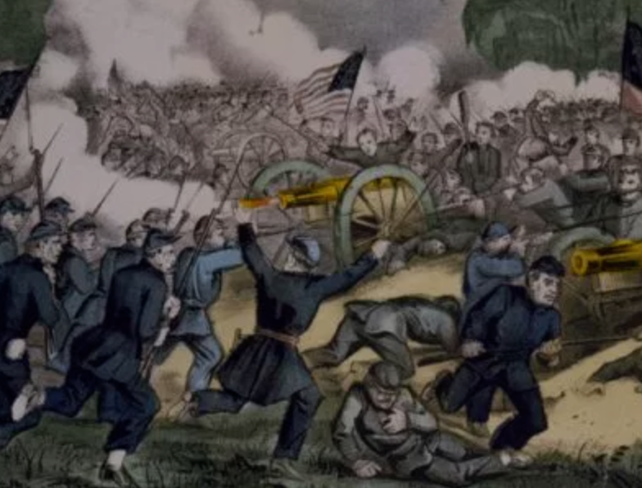
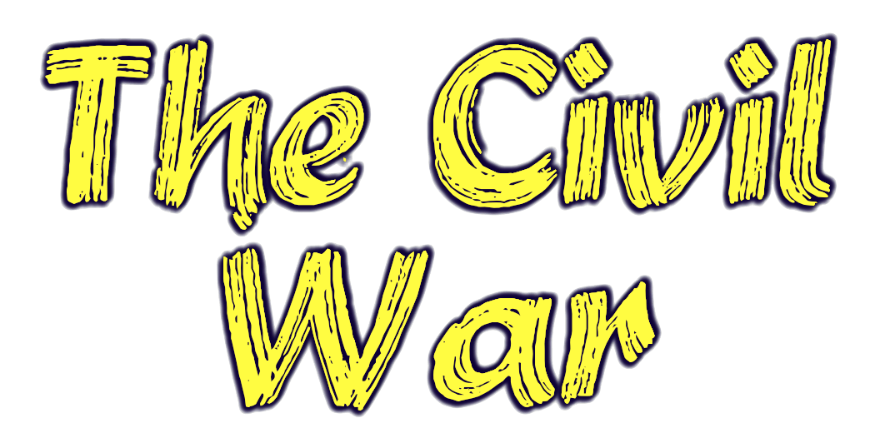

Slide 2
Abraham Lincoln’s victory in 1860 prompts secession. Why?
He did not publicly call for slavery to end (only wanted to stay where it was and not spread)
Six out of ten people voted against him
He did not even appear on the ballot of several southern states

Slide 3
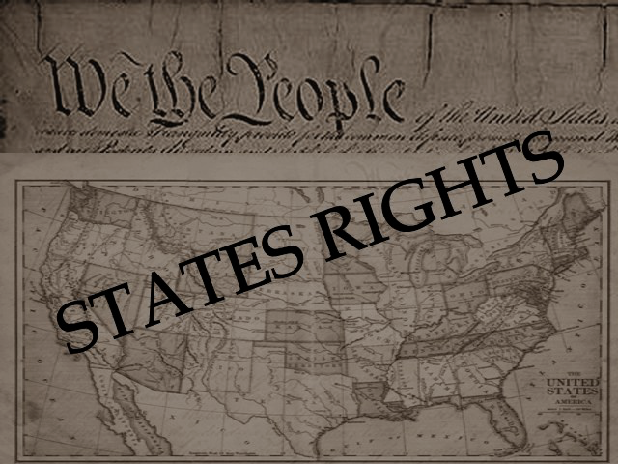
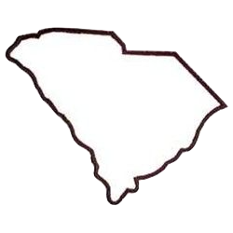
The south defends secession with the states’ rights theory.
The belief that the states hold more power than the federal government
South Carolina was the first to secede, just six weeks after the election.
Nothing in the Constitution prevents slavery, so it is a state issue

Slide 4
Eleven seceding states meet in Montgomery, AL in Feb 1861
Jefferson Davis named President and Alexander Stephens named Vice President
Confederation = government where states all share equal power
Federal = government where states give power to a stronger national government
Together, they create the Confederate States of America
Create CSA Constitution that guarantees protection of slavery

Slide 5
The Crittenden Compromise was proposed by John Crittenden (KY) to hopefully avoid war
Obviously this did not pass – no way Republicans are voting for this.
This would have been the 13th amendment, and it would have protected slavery forever where it already existed.

Slide 6
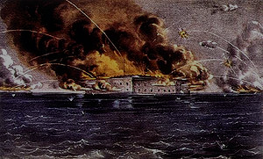
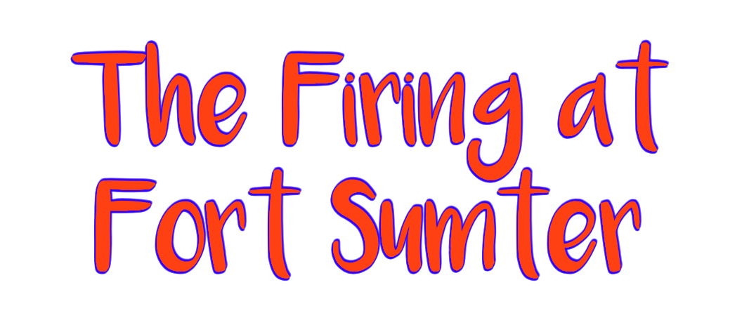

Slide 7
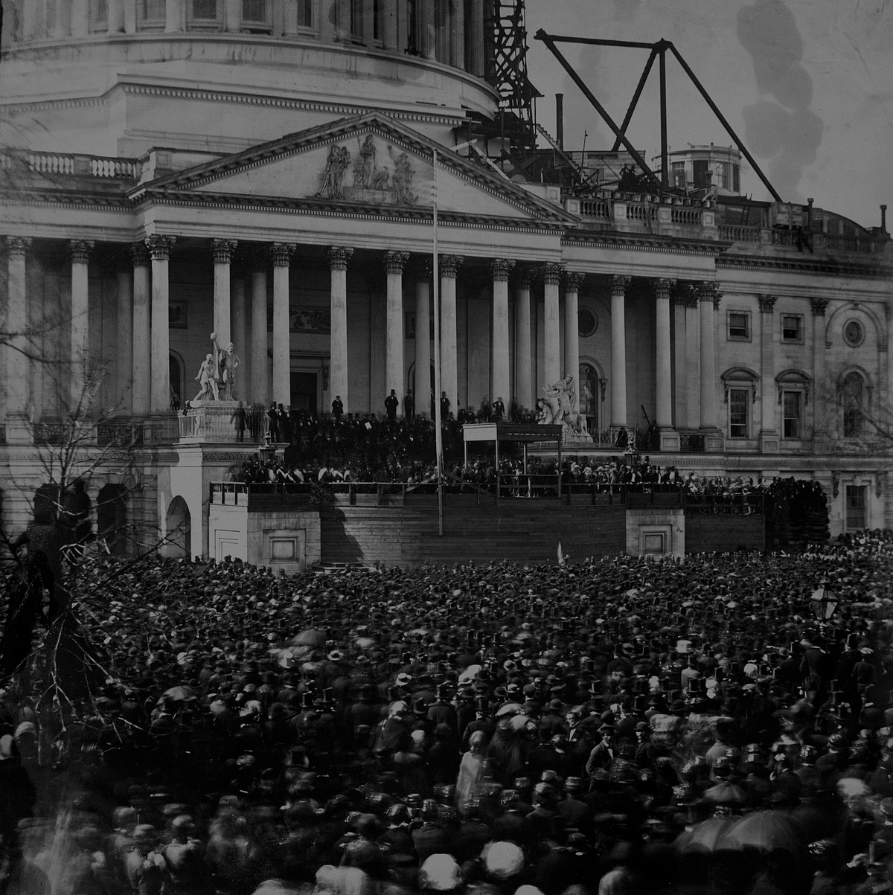
At Lincoln’s inauguration, he promised that US government would maintain all its property in the southern states
Fort Sumter, in Charleston, SC, was a federal fort in the south. It was running low on supplies.

Slide 8
Lincoln had a choice: restock the fort and exert federal power over it, or let it go to the south.
He chose to restock the fort, enter the south, and not back down.

Slide 9
Before supply ships could arrive, Confederate General Pierre Beauregard ordered the firing upon the Union-held fort on April 12, 1861.
He calls it a “rebellion” and not a war. He does not believe the states have the ability to secede and create a separate country. They are “rebelling” in his eyes.
Lincoln immediately called for 75,000 troops to put down the rebellion.

Slide 10
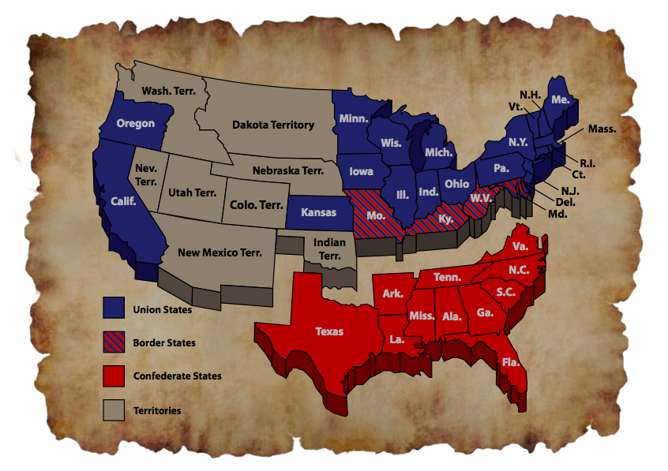
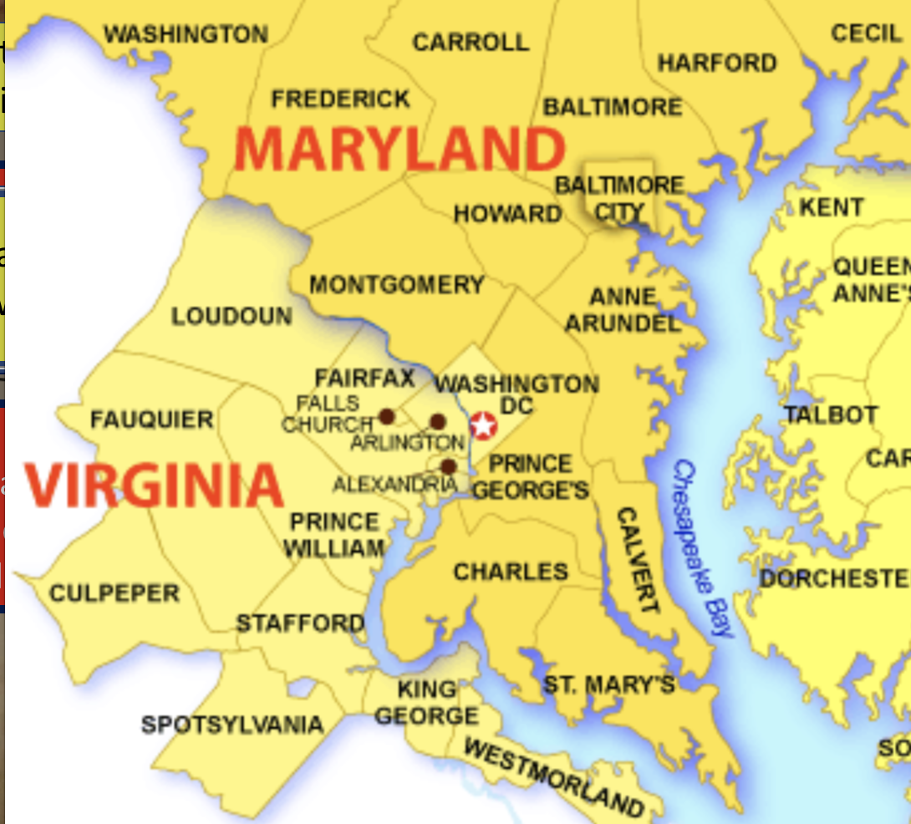
Even though slavery is at the center of the Civil War, it is not out in the open yet.
West Virginia (in 1863)
Several states fought with the Union who had slavery. These are called border states.
Delaware
Quick talk and write: Why is Maryland so important to Lincoln? Why must he keep Maryland in the Union?
Lincoln has not demanded slavery come to an end (just cannot spread west)
Maryland
Missouri
Kentucky

Slide 11
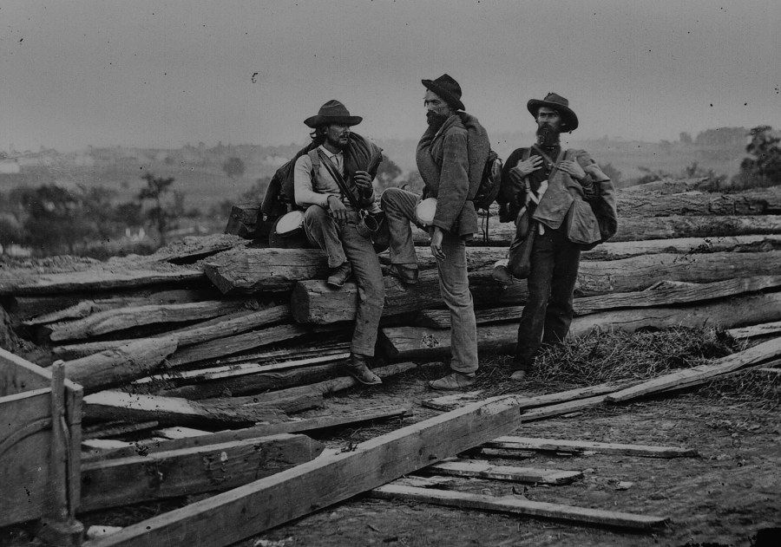
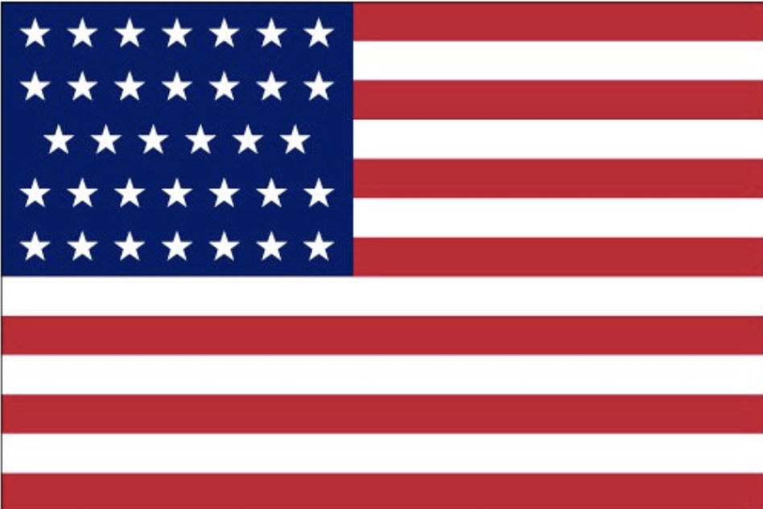
The USA holds several advantages over the CSA when war begins…
More troops
Superior generals
Larger population
HOWEVER, the South had…
Lee was even asked by Lincoln first to lead the North!
Strong manufacturing base
North has to invade the south (much harder to do)
Established army and navy

Slide 12
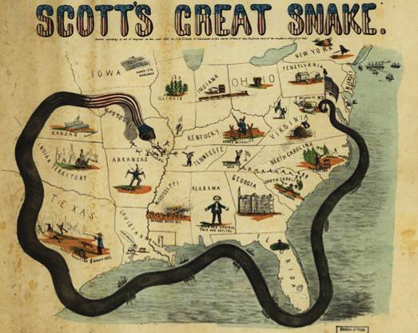
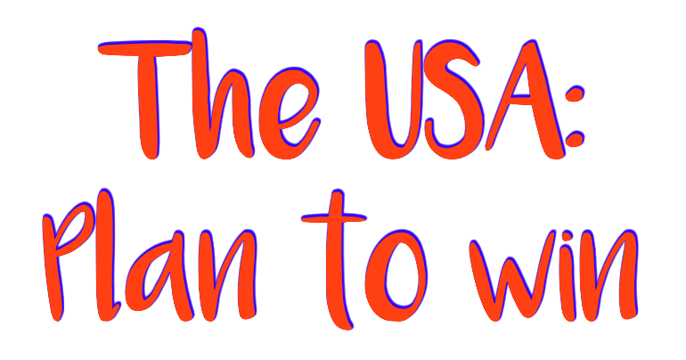
The Anaconda Plan
Take the capital at Richmond
Control the Mississippi River
Separate the west from the south
Blockade the coastline (since the south relies on imports, this will begin to “starve” the south)
Notes:
This plan maximized the North’s industrial advantages but required better leadership than North had

Slide 13
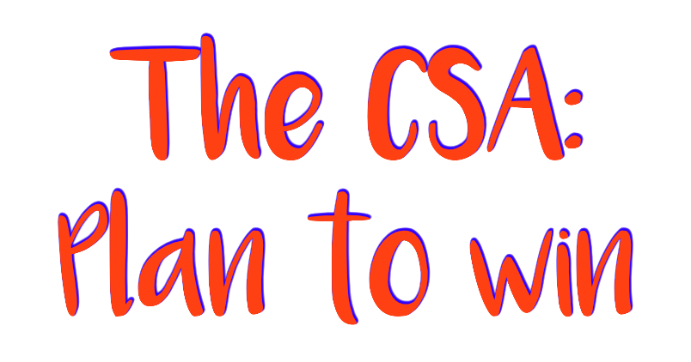
Make the North quit
Attract a foreign ally
Wait it out.
Bring the war north
They don’t have to win. They just cannot lose.
Since the CSA lacks resources and manpower, the south will use “King Cotton Diplomacy” to try to draw in a foreign country (mainly Britain or France)
By dragging the war out, northern civilians will get sick of the war and call for their political leaders to bring it to an end
At some point, the CSA needs to attack the north.
Make northerners feel what war is like – this will make them want to give up.
Pick and choose the battles where they can win
Since the South expects close to 80% of the world’s cotton, many countries have an interest in the South winning
They cannot compete with the Union in terms of resources; they cannot replenish losses as easily

Slide 14
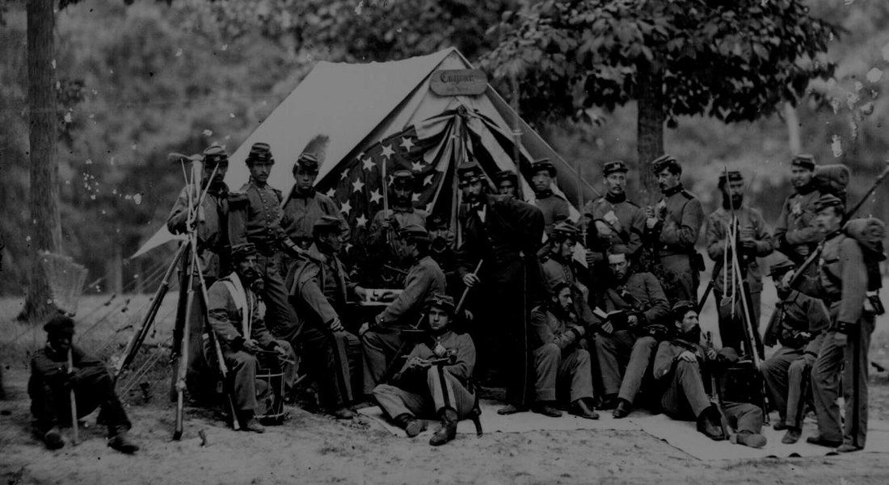
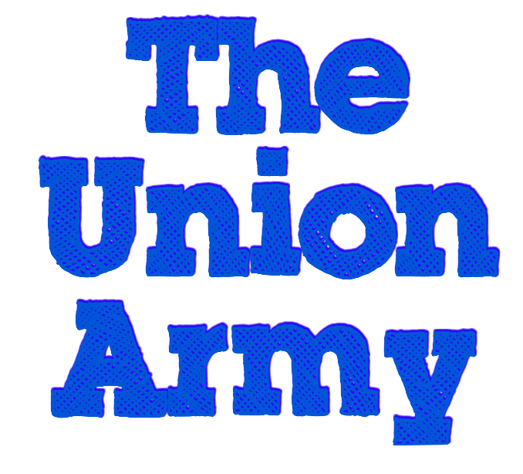

Slide 15
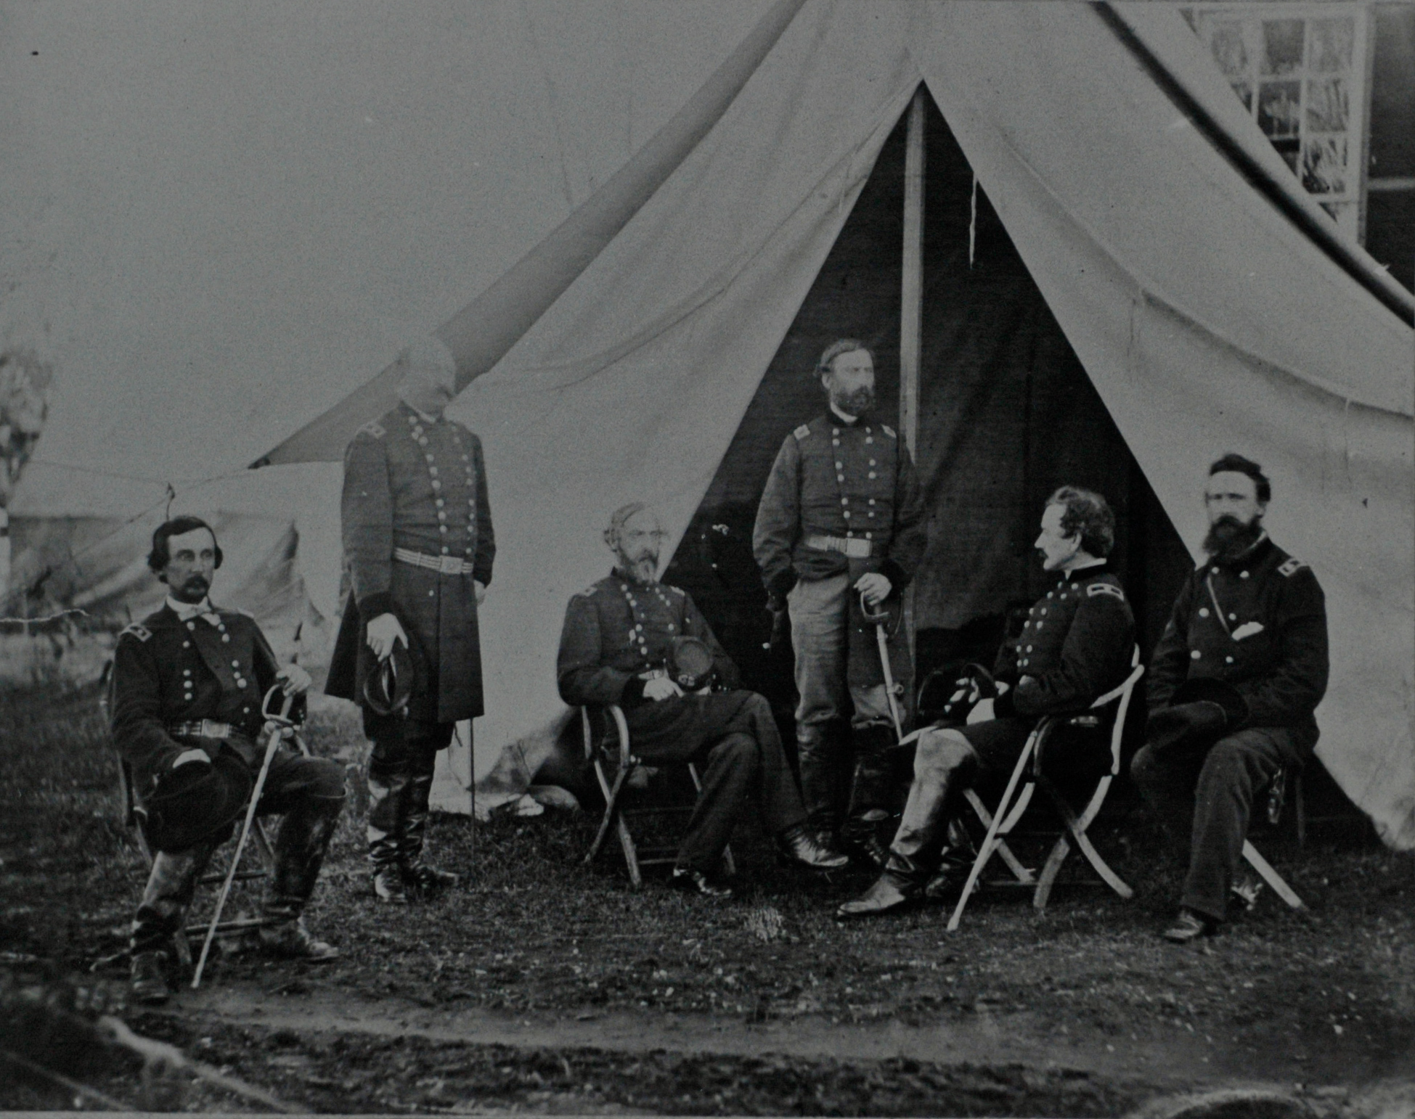
Led by a revolving door of Union generals
Operated mainly in the Eastern Theater with the main goal of capturing Richmond VA, the Confederate the capital.
McClellan
Meade
Burnside
Hooker
Grant

Slide 16
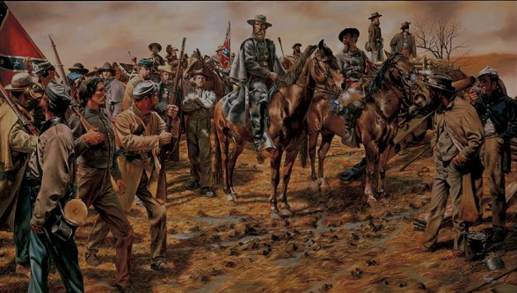
Led by…
Grant
Sherman
Operated mainly in the Western Theater with the goal of dividing the west from the south and gaining control over the Mississippi River

Slide 17
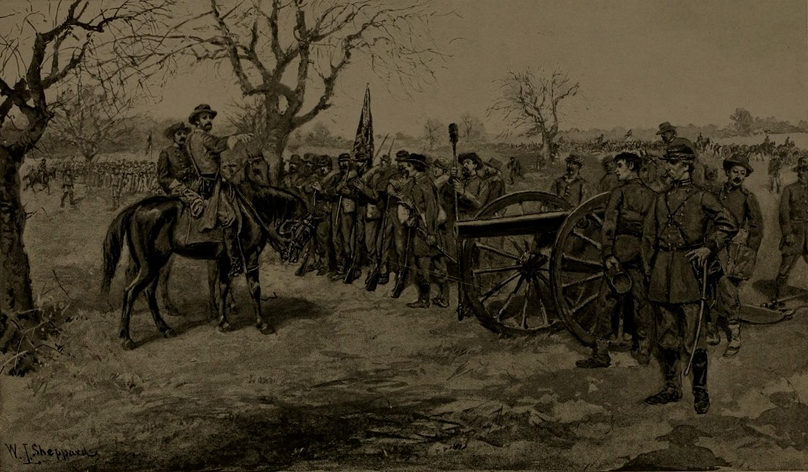
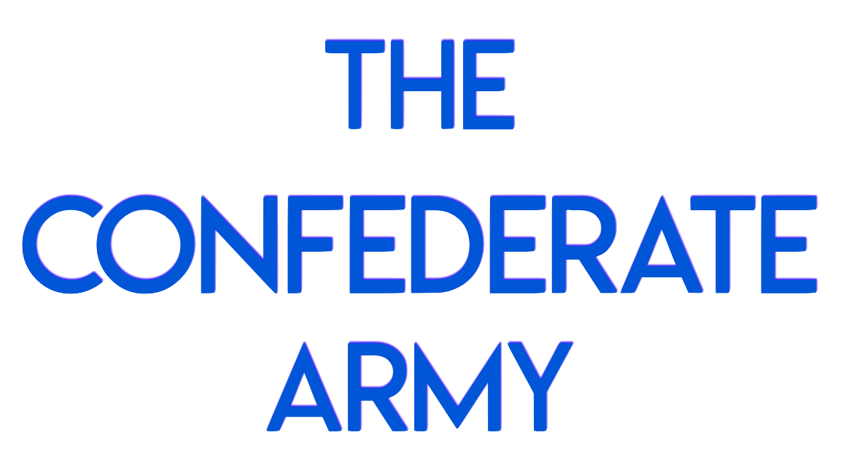

Slide 18
The main confederate army, centered in northern Virginia, led by famed General Robert E Lee.

Slide 19
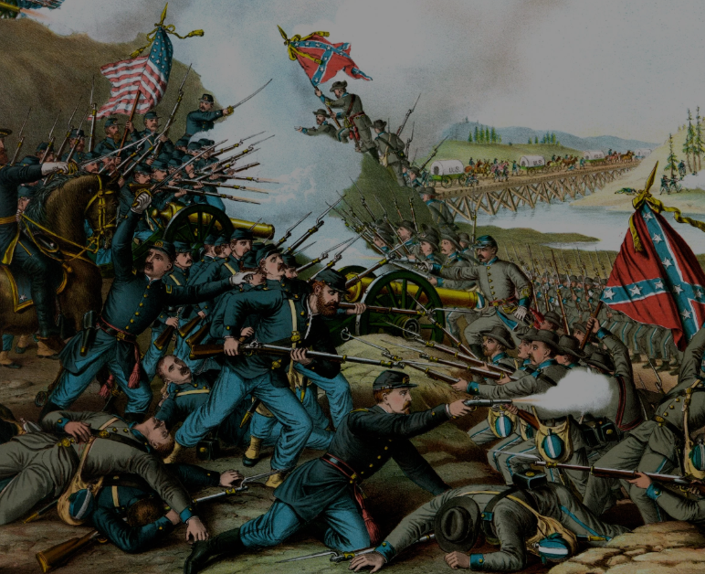
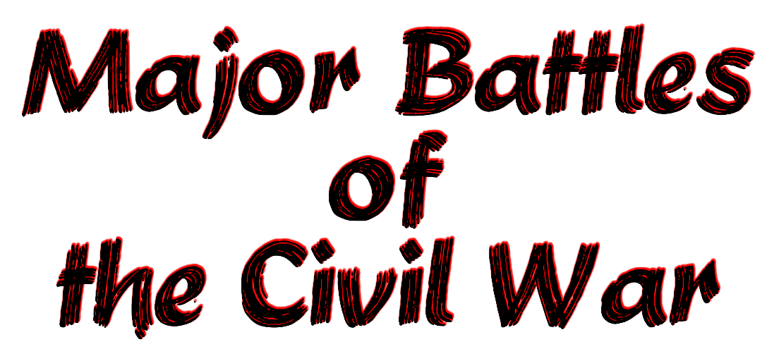

Slide 20
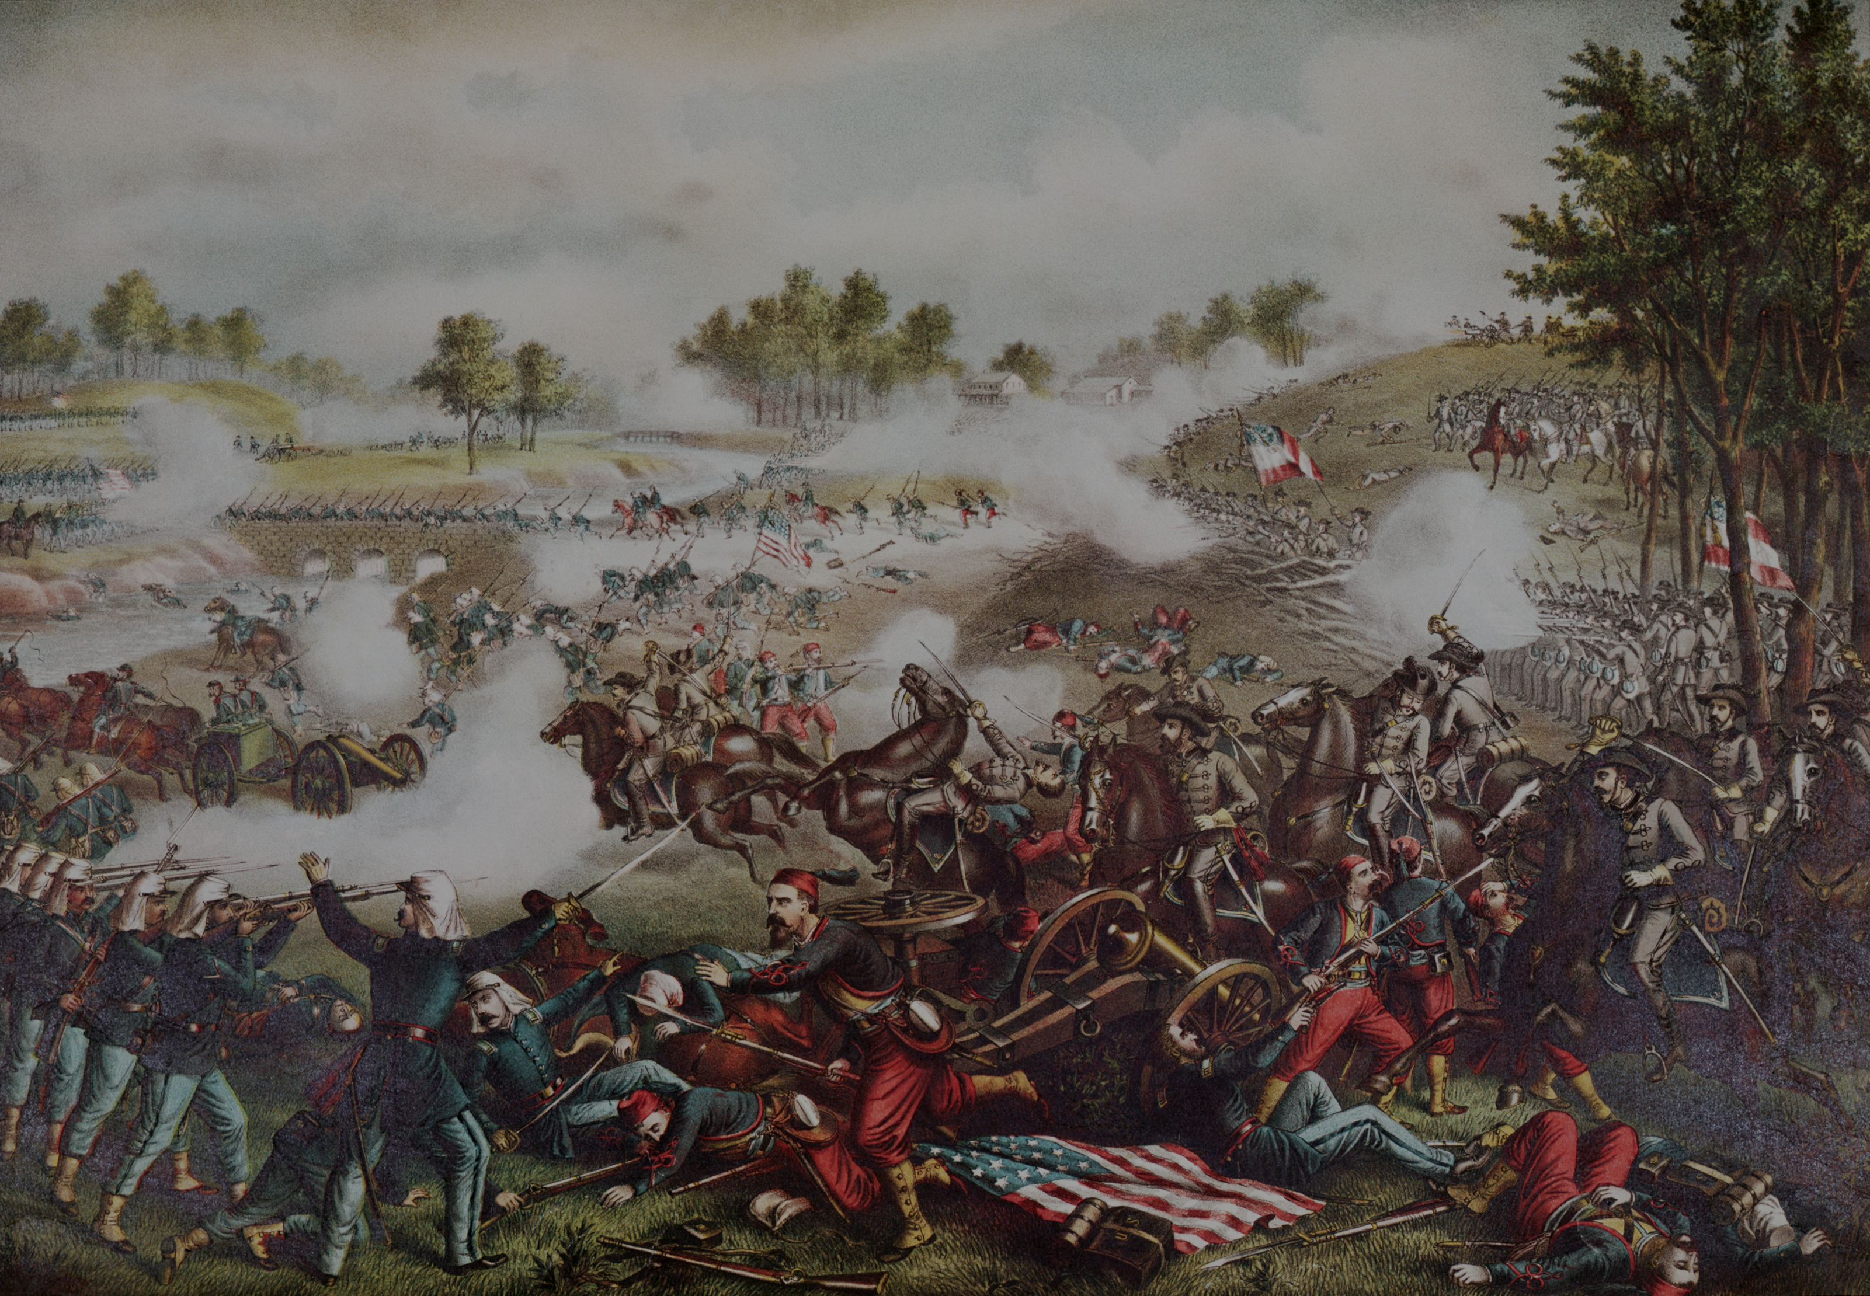
Battle of Bull Run
Also called Manassas
(Bull Run is a creek that ran through Manassas)
First battle and major CSA win; convinced the war wouldn’t be one-sided.

Slide 21
Battle of Shiloh
First battle in the west; USA win and Tennessee falls back under Union control

Slide 22
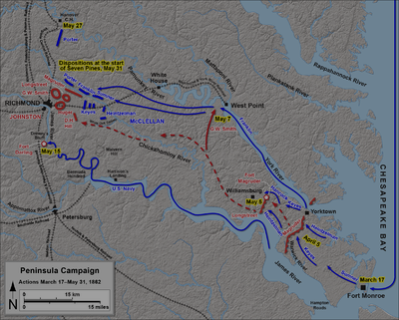
The Peninsula Campaign
a 7 day campaign by the USA to seize Richmond. It fails miserably, and the CSA actually win 10 battles over those 7 days.

Slide 23
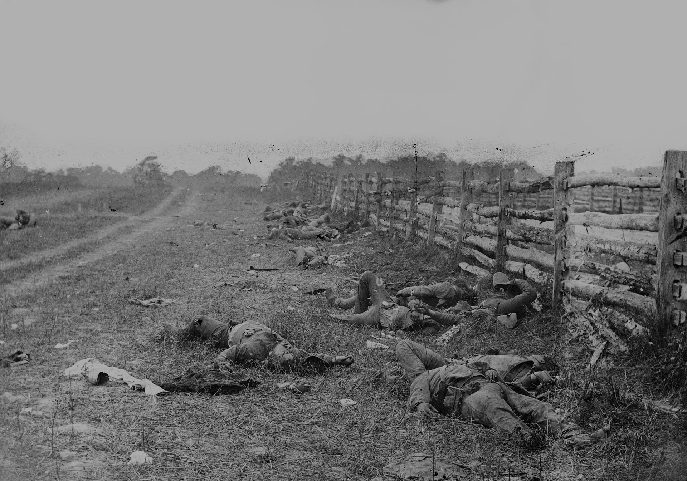
Battle of Antietam
Nobody really wins, but Lincoln seizes the moment
Lincoln issues the Emancipation Proclamation that frees slaves in the Confederacy (not the border states, he cannot lose Maryland)
Robert E Lee’s first invasion of the north. He tries to attack a northern city (Harrisburg, PA) to convince Britain or France that the CSA has what it takes to win.
This turns the war’s focus to a war about slavery
Britain and France cannot morally support the war now since they had outlawed slavery decades earlier.

Slide 24
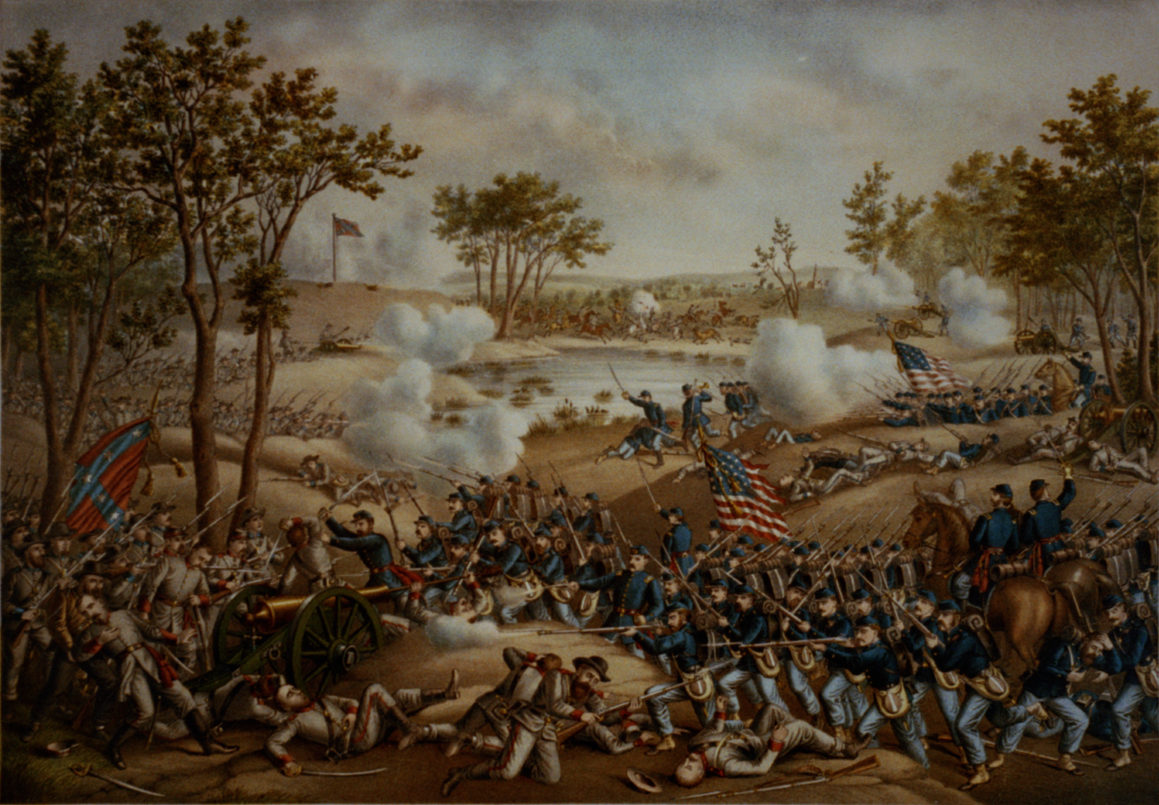
Battle of Fredericksburg
Known as Union’s biggest folly (mistake) for repeatedly trying to cross a river under heavy gunfire. Big CSA win .

Slide 25
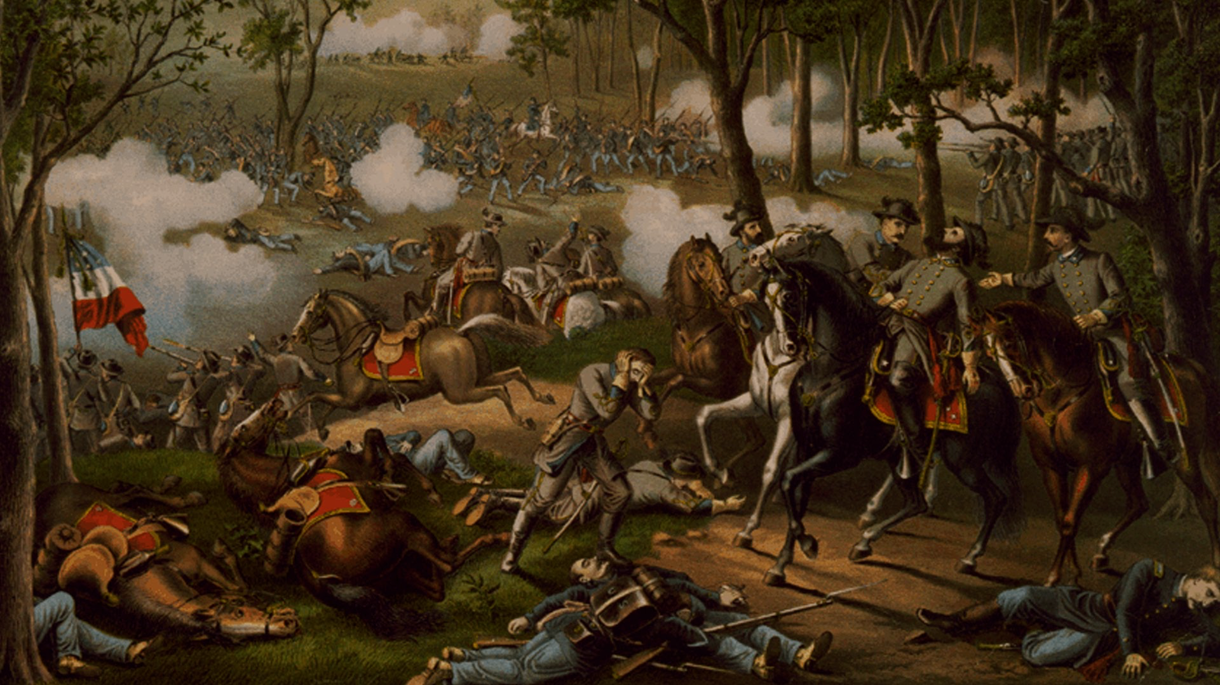
Battle of Chancellorsville
Huge CSA win. Lee defeats Union army twice his size.

Slide 26
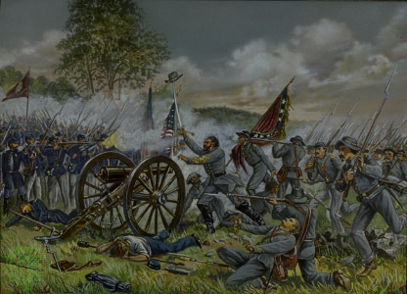
Battle of Gettysburg
Confederacy wins days 1 and 2 of the battle
The CSA charge is devastated, and the Union win at Gettysburg.
Lee uses momentum from recent victories to invade the north again. His army is stopped in Gettysburg, PA where a massive 3-day battle takes place.
This is the turning point in the war.
During day 3, Lee orders General George Pickett to march across an open field and charge the Union line.

Slide 27
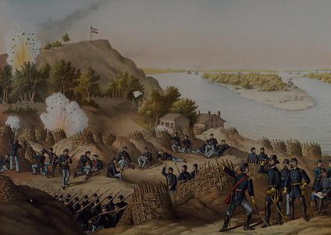
Siege of Vicksburg
Vicksburg sits atop a mountainside and guards traffic down the Mississippi River. Union army under Ulysses Grant lays siege to Vicksburg for several weeks until the city surrenders. This gives Union control of Mississippi River.

Slide 28
Sherman’s March to the Sea
Union general William Tecumseh Sherman is ordered to make the south surrender; he and his men march from Atlanta to Savannah, GA, laying waste to everything of value.
Fields are burned, railroads destroyed, in an effort to make the CSA surrender.

Slide 29
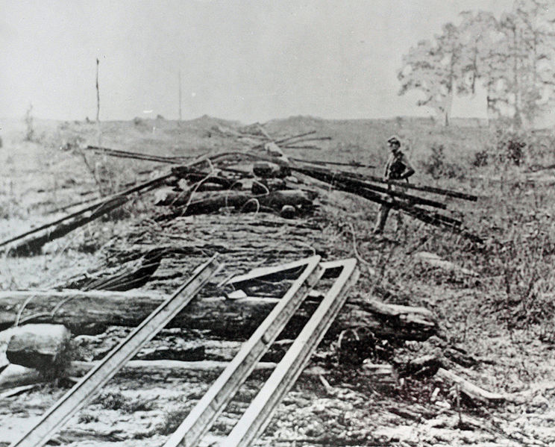
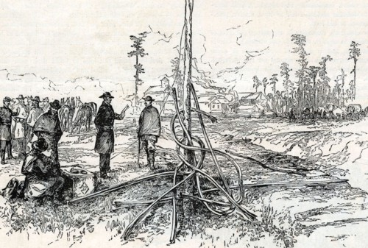
“Sherman’s Neckties” refers to a destroyed railroad line

Slide 30
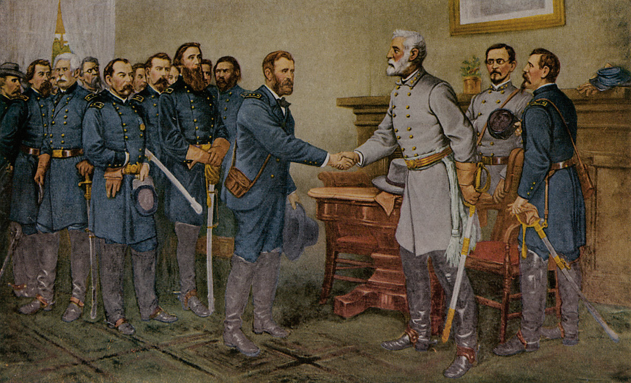
The Battle of Appomattox Courthouse
Quick talk and write:
Why do you think Lincoln is so lenient on the South?
The CSA surrenders at Appomattox. Lincoln ensures the terms of surrender are very lenient. As long as soldiers lay down their arms and never pick them up again for war, there will be no punishment.

Slide 31
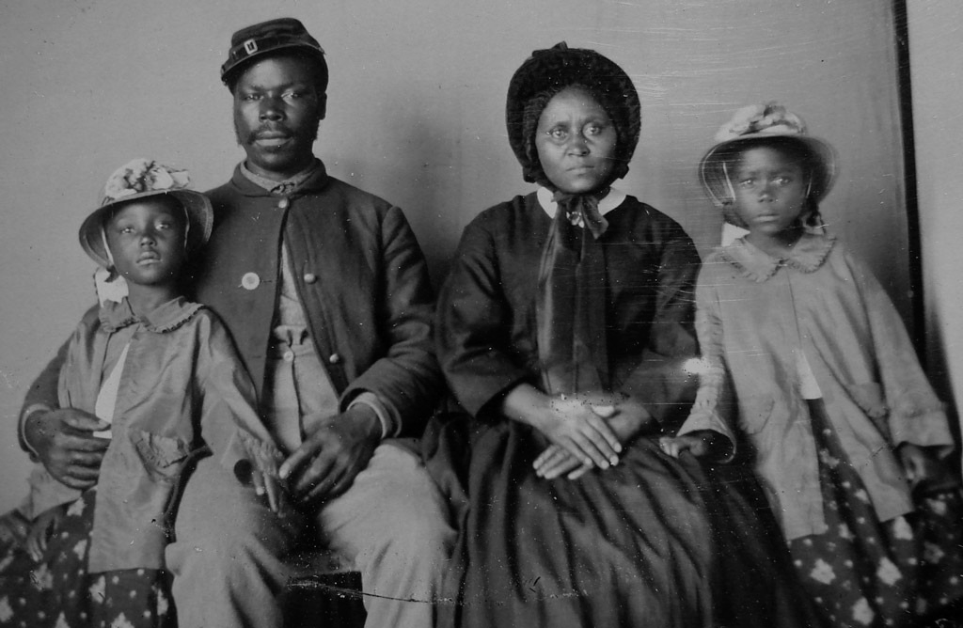
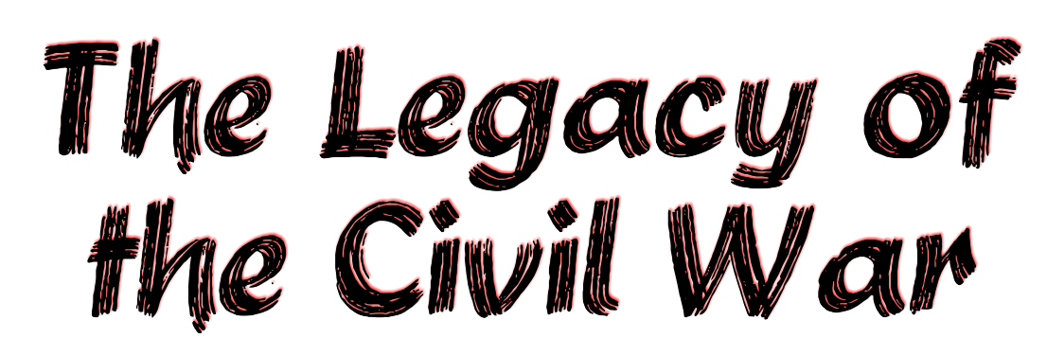

Slide 32
The Union wins and slavery will soon be abolished.
13th: ends slavery
The 13th, 14th, and 15th amendments will be ratified in the next few years that…
14th: Guarantees citizenship to former slaves
15th: Provides former slave males the right to vote

Slide 33
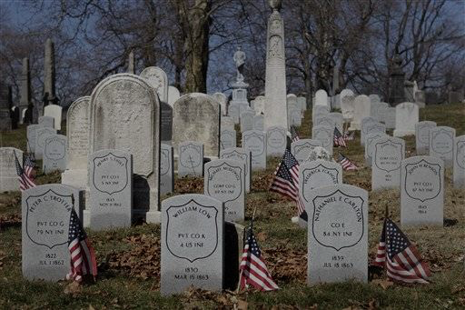
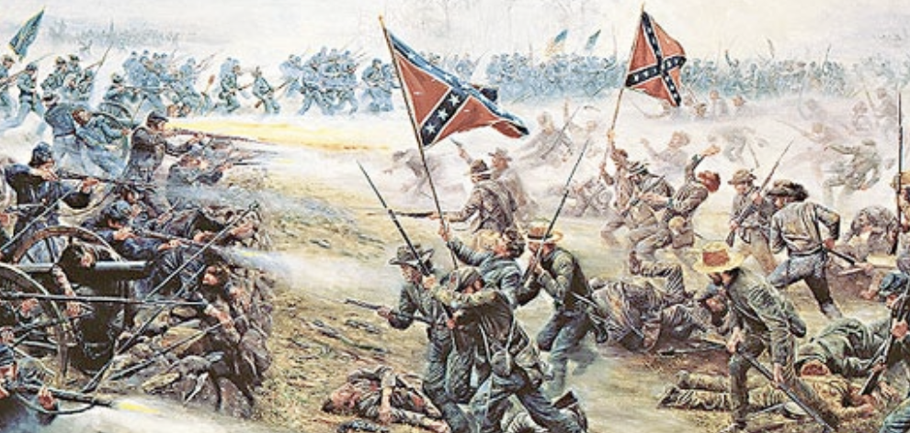
It still stands as the deadliest war in US history.
When both sides still use old-school fighting methods of standing in rows…
Minie ball and cone-shaped bullets
New, deadly technology helps create these record fatalities
Land mines, booby traps, shrapnel
Gatling machine gun
the casualties are off the charts.

Slide 34
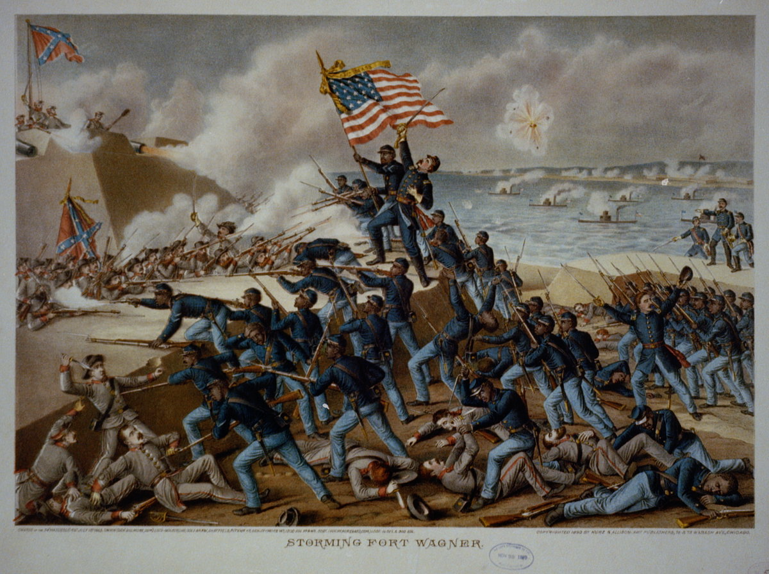
New-found respect for many
Women sign up to serve as nurses, bookkeepers, spies
Most famous was Clara Barton, founder of the American Red Cross
The Massachusetts 54th regiment was the first all-black regiment to fight in US history
Nativism decreased as Irish and Germany immigrants sign up to fight

Slide 35
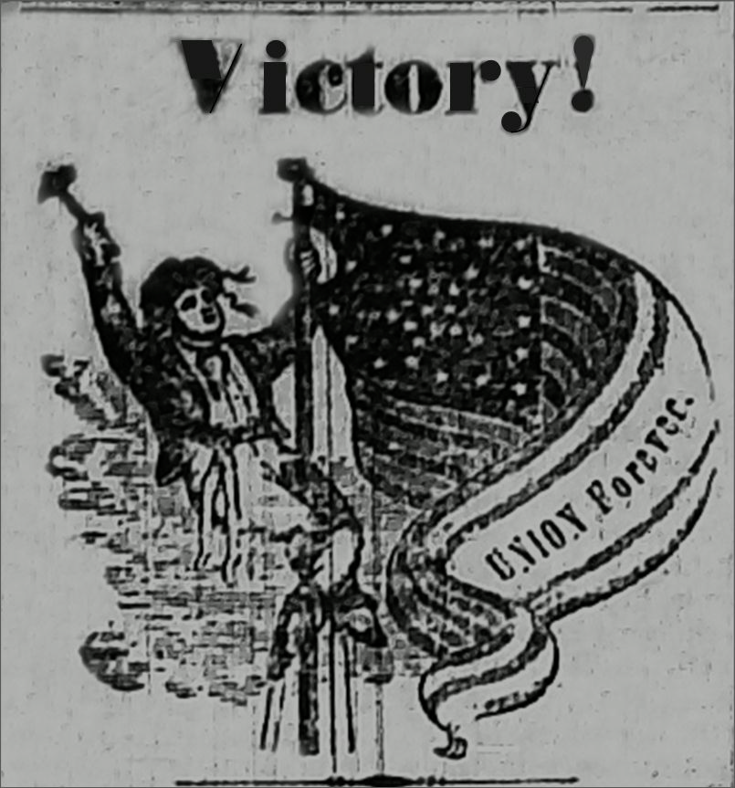
National government is supreme
The Civil War established that states rights are secondary to the national government.
Southern calls for nullification of federal law are ended.

